Slide 1
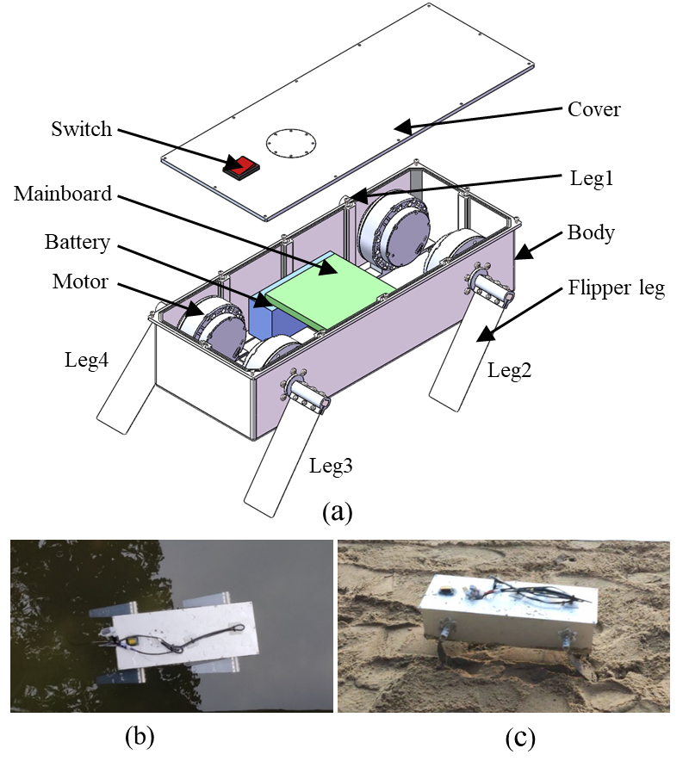
Passively Deformable Flipper Legs for An Amphibious Quadruped
Ning Guo, Zujun Bai, Wei Gao and Shiwu Zhang
Department of Precision Machinery and Precision Instrumentation,
University of Science and Technology of China, China.
Haoyao Chen
College of Mechanical Engineering and Automation,
Harbin Institute of Technology Shenzhen, China.
An amphibious quadruped that possesses four newly designed passively deformable flipper legs.
Five passively deformable flipper legs with different stiffness distribution.
Experiments were conducted under three different environments to find the optimal stiffness distribution.

