Slide 1
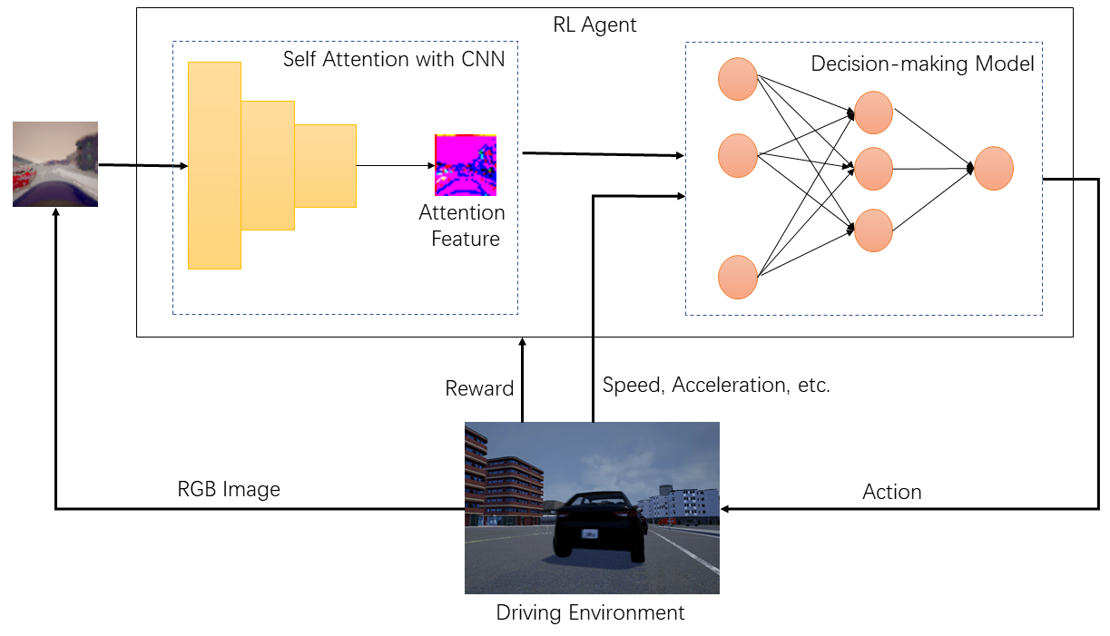
Towards Autonomous Driving Decision by Combining Self-attention and Deep Reinforcement Learning
Meiling Chen, Yanjie Li, Qi Liu, Shaohua Lv, Yunhong Xu, Yuecheng Liu
Department of Control Science and Engineering,
Harbin Institute of Technology (Shenzhen), Shenzhen
We proposed an framework based on self-attention model and DRL for autonomous driving.
We used the self-attention model to reduce the dimension of image.
we used DDPG algorithm to complete the autonomous driving task.
The results show that the proposed framework performs better than existing methods.
Framework overview of the system.

