Slide 1
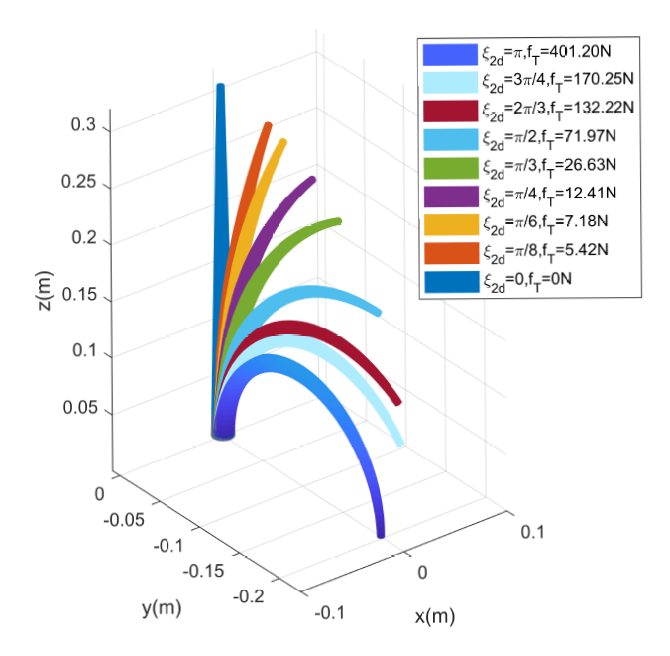
Dynamics modeling of a soft arm under the Cosserat theory
Jie Ma, Zhiji Han, Linsen Yang, Gaochen Min, Zhijie Liu, Wei He.
Automation and Electrical Engineering, University of Science and
Technology Beijing, China
In this paper, inspired by the Lagrangian model of a rigid robot, a Newton-Euler inverse dynamics algorithm for an equivalent continuous manipulator is adopted to compute all matrices of the Lagrangian inverse dynamics model about the soft arm.
The iterative process is also improved to increase the computational efficiency.
Eventually, a minimal set of ordinary differential equations is given for later control design.
The relationship between the tension and desired angular strain

