Slide 1
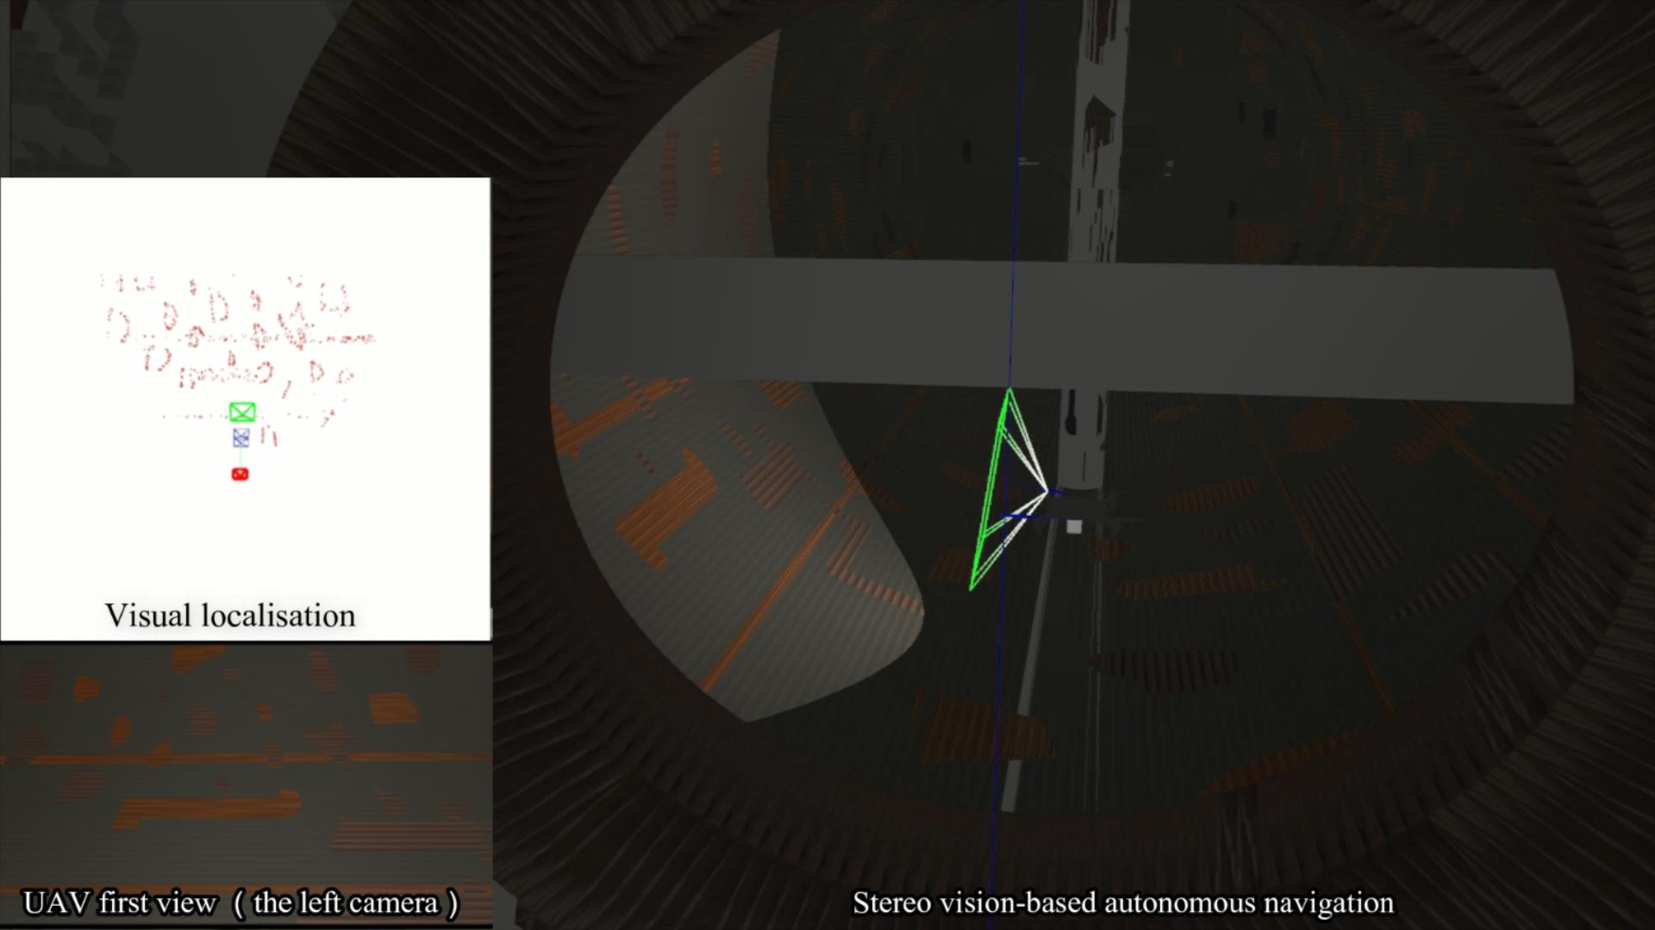
Stereo Vision-based Autonomous Navigation for Oil and Gas Pressure Vessel Inspection Using a Low-cost UAV
Leijian Yu, Erfu Yang, Beiya Yang, Andrew Loeliger and Zixiang Fei
Department of Design, Manufacturing and Engineering Management, University of Strathclyde, United Kingdom
The ORB-SLAM3 is improved by the image contrast enhancement capability.
A stereo vision-based autonomous navigation approach is developed.
The ROS-Gazebo-PX4 simulator is customised deeply to simulate the real scenario.
The effectiveness of the proposed approach is demonstrated in the developed simulation environment.
UAV autonomous navigation inside of the pressure vessel

