Slide 1
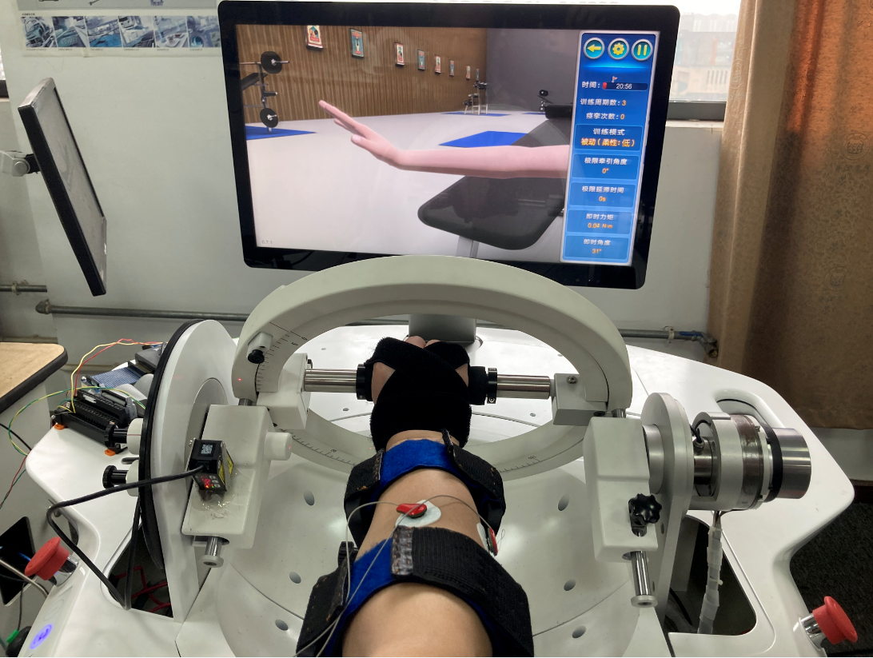
Robot-assisted quantitative assessment of
axis misalignment of wrist joint
Dong Xu, Han Xu, Yibin Li, Xu Zhang, Xiaolong Li,
ATM& RERC, Tongji Zhejiang College, China
Jianming Fu
the Second Affiliated Hospital of Jiaxing University, Jiaxing, China
proposed a quantitative assessment method of axis misalignment of wrist joint by introducing a self-aligning
mechanism based on the rehab-robot.
the axis variation of wrist joint can be mimicked naturally and quantitative values can be recorded to assess axis misalignment.
Experiments were conducted and ICC (2, 1) ≥ 0.866, and SEM ≤ 1.34 mm.
Wrist rehabilitation device with self-aligning
Mechanism and sEMG was attached.

