Slide 1
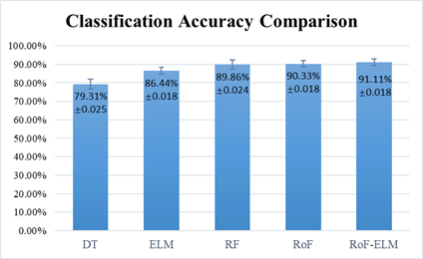
Gesture Recognition by Rotation Forest-Based
Extreme Learning Machine
Fulai Peng, Cai Chen, Xikun Zhang, Xingwei Wang, Changpeng Wang
Shandong Institute of Advanced Technology, Chinese Academy of Sciences
Lin Wang
Shenzhen Institutes of Advanced Technology, Chinese Academy of Sciences
This paper proposes a rotation forest-based extreme learning machine method (RoF-ELM).
The proposed method enhanced the stability and accuracy of ELM in recognizing gestures from sEMG signals across different subjects.
Results show that the RoF-ELM method have the highest accuracy across different subjects with relatively short runtime compared with decision tree (DT), ELM, random forest (RF), and RoF methods.
Classification accuracy comparison between different mehtods

