Slide 1
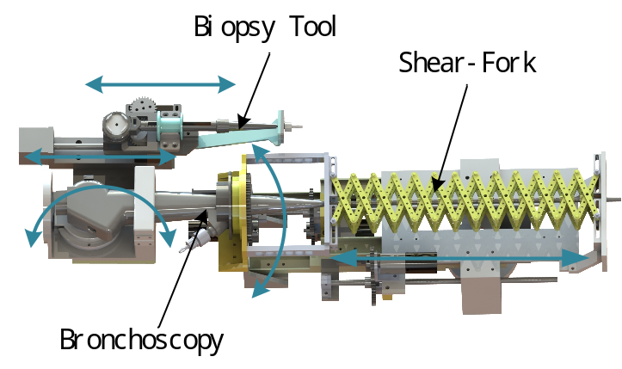
Bronchoscopic Interventional Surgery Robot which Constrained by a Shear-Fork Mechanism
Jie Li¹ and Chao Han²
School of Mechanical Engineering,Shenyangjianzhu University, China
Tao Yu³ , Xiao He⁴, and Hao Liu⁷
State Key Laboratory of Robotics, Shenyang Institute of Automation, China
Zhenming Jiang⁵ and Lei Sun⁶
First Hospital of China Medical University , China
Research and Development of Bronchoscope Interventional Robot Delivery Mechanism.
Requirements Analysis and Master Plan.
Structure Design and Build Control System.
Model Testing and Analysis.
Bronchoscope and Biopsy Tool Delivery Control Device

