Slide 1
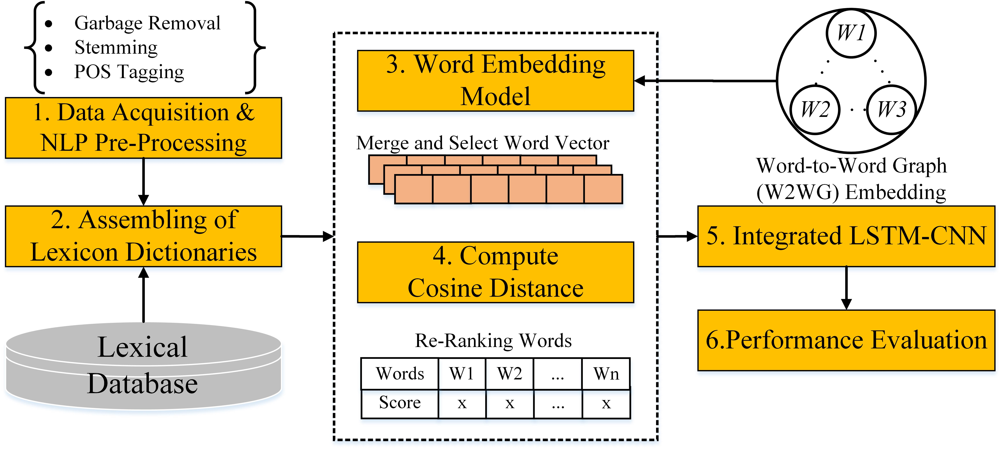
IEEE RCAR 2020 Digest Template
WRS: A Novel Word-embedding Method for Real-time Sentiment with Integrated LSTM-CNN Model
Abdur Rasool1,2, Qingshan Jiang1, Qiang Qu1, Chaojie Ji3
1Shenzhen Key Lab for High Performance Data Mining, Shenzhen Institute of Advanced Technology, Chinese Academy of Sciences, China
2Shenzhen College of Advanced Technology, University of Chinese Academy of Sciences, China
3Shenzhen Institute of Advanced Technology, Chinese Academy of Sciences, Shenzhen, China
Propose a novel Word-to-Word Graph (W2WG) embedding for the real-time sentiment (WRS).
Two neural networks integrate (LSTM-CNN) to gain the highly efficient features.
Experiment with IMDB and real-time Twitter data and achieved effective results.
Proposed real-time sentiment method (WRS) with word embedding and integrated LSTM-CNN models

