Slide 1
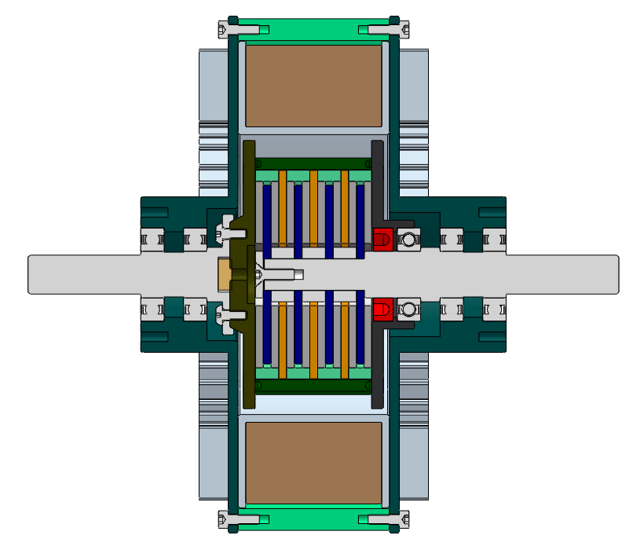
Transmission Characteristics of Compliant Joint for Rehabilitation Robot Based on Magneto-rheological Fluid Variable Stiffness
Wei Wei and Fugang Yi and Bilei He and Shibo Cai and Guanjun Bao
College of Mechanical Engineering, Zhejiang University of Technology, China
Magneto-rheological fluid is kind of the solid-liquid materials with magneto-sensitive rheological property;
The compliant joint of robots based on magneto-rheological fluid has the characteristics of active variable stiffness;
The shear transmission of magneto-rheological was proposed to facilitate the operation compliance and intrinsic safety.
Compliant Joint Coupling

