Slide 1
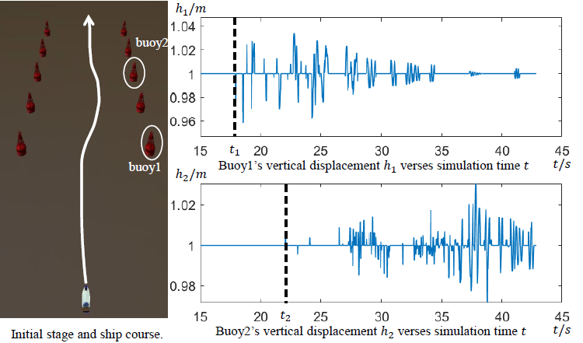
Computational Efficient Simulation of Kelvin Wake for Unmanned Surface Vehicles
Yao He, Qinbo Sun, Weimin Qi, Xiaoqiang Ji and Huihuan Qian
Shenzhen Institute of Artificial Intelligent and Robotics for Society (AIRS)
The Chinese University of Hong Kong, Shenzhen, Guangdong, China.
Propose a computation efficient simulation of Kelvin Wake using J.J. Stoker’s analysis
Modify J.J. Stoker’s model to make the simulation accurate
Equip the simulation function into a Unmanned Surface Vehicles simulator

