Slide 1
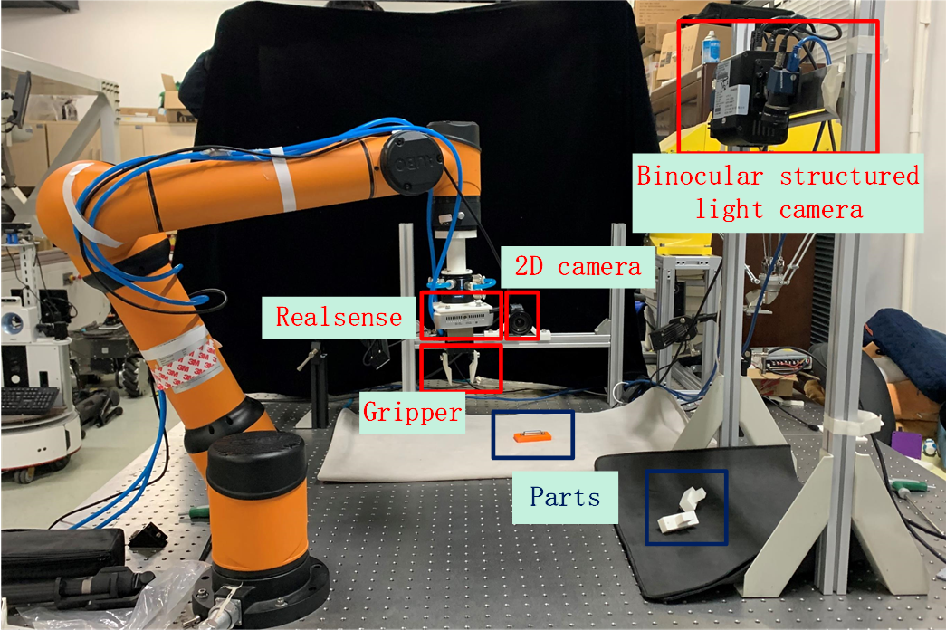
High-Precision Pose Estimation Method of the 3C Parts by Combining 2D and 3D Vision for Robotic Grasping in Assembly Applications
Nan Zhang, Yixin Xie, Xiansheng Yang, Haopeng Hu and Yunjiang Lou
School of Mechanical Engineering and Automation, Harbin Institude oaf Technology, Shenzhen, China
This paper presents a high-precision 6D pose estimation method for robotic grasping in assembly applications .
The Mask R-CNN is used to map and extract point cloud of the component.
An accurate estimation of component pose is got by PCA and ICP , and the robot can grasp accurately after hand-eye calibration.
The high-precision assembly experiment platform

