Slide 1
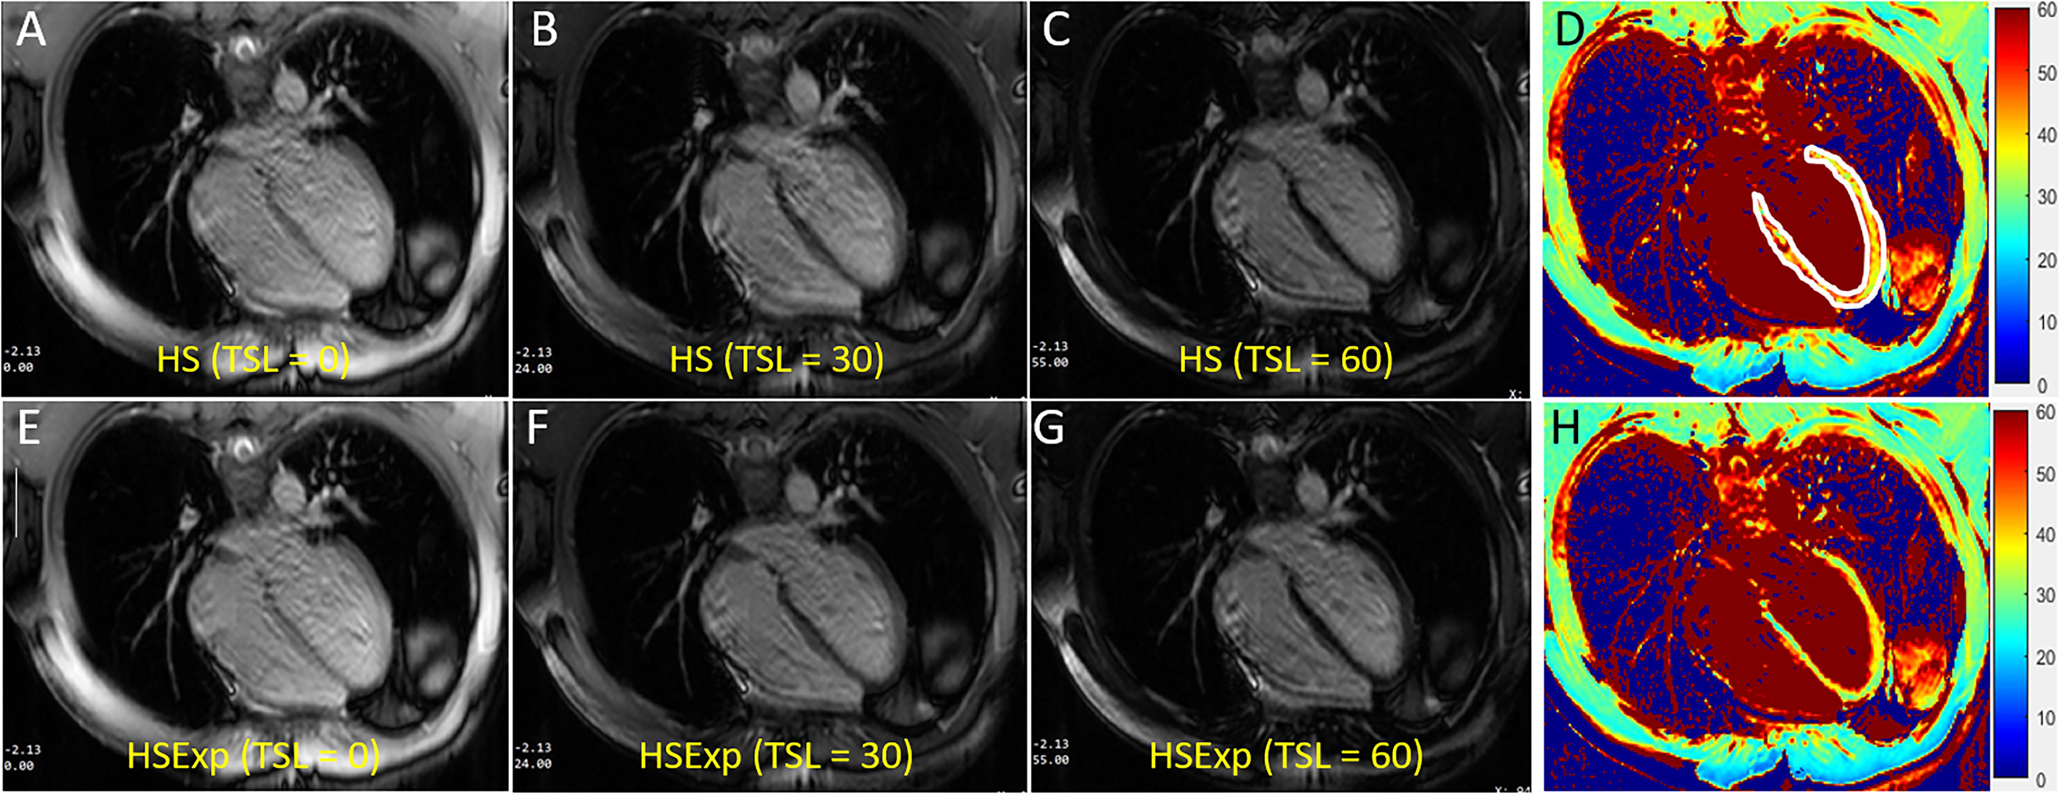
The Optimization of Adiabatic Pulses with Constant Amplitude Spin-lock for MR T_{1ρ} Imaging
Yuxin Yang, Xi Xu and Zhongmin Chen
Biomedical Engineering, Chongqing University of Technology , China
Yuanyuan Liu, Yanjie Zhu and Dong Liang
SIAT, Chinese Academy of Sciences, China
HS and HSExp adiabatic spin-lock pulses were optimized using a duration of 4ms.
Images with higher SNR were obtained compared with those using pulses of 8ms.
Almost equivalent mapping quality was achieved compared with that using pulses of 8ms.
The T_{1ρ}-weighted images (TSL = 0, 30, 60ms) and T_{1ρ} maps using two types of adiabatic pulses in cardiac imaging

