Slide 1
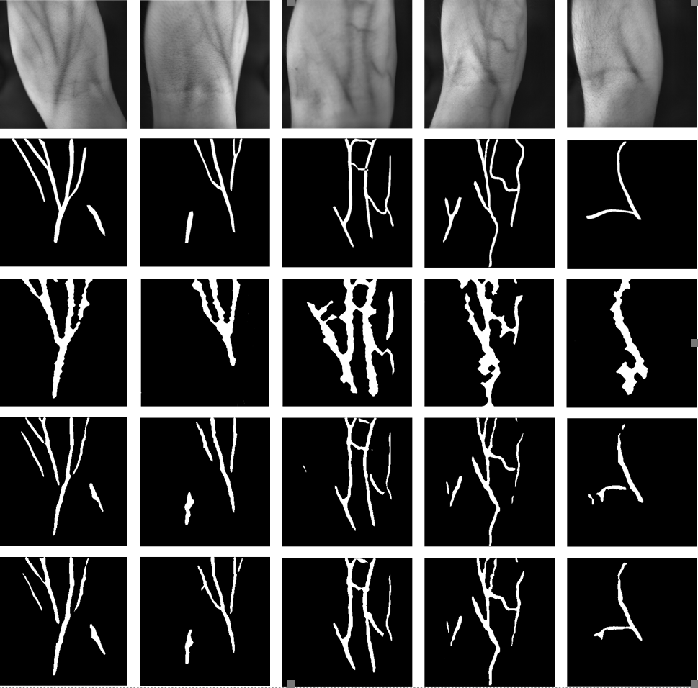
Automatic Venous Segmentation in Venipuncture Robot Using Deep Learning
Tianbao He, Chuangqiang Guo, Li Jiang, and Hansong Liu
State Key Laboratory of Robotics and System,
Harbin Institute of Technology, China
Establish a data set of human arm venous blood vessels for training deep learning models.
Use deep learning models to replace traditional digital image processing methods to identify veins.
Real-time automatic segmentation of veins in the venipuncture robot.
Visualize blood vessel result

