Slide 1
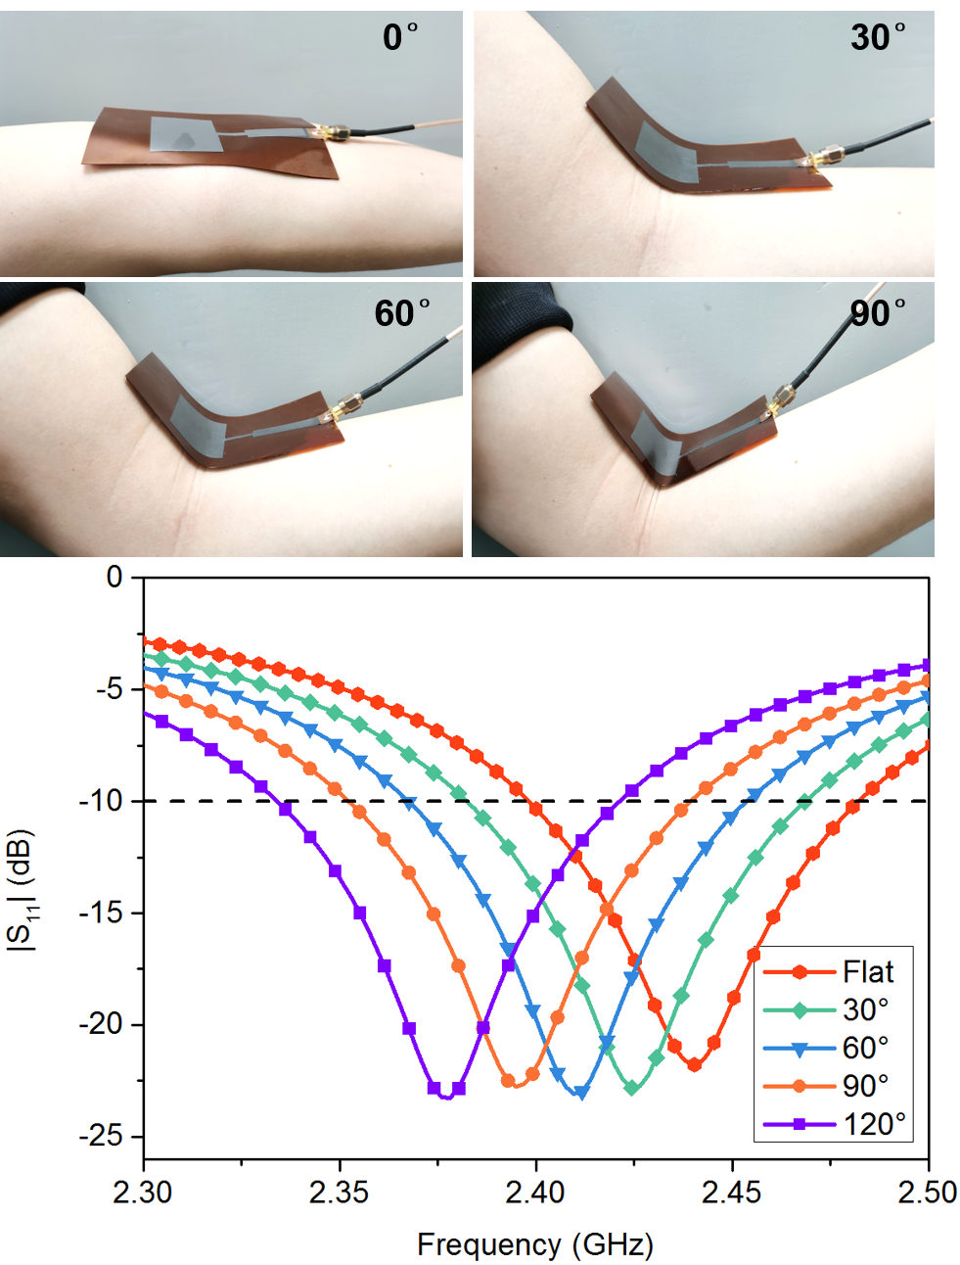
Graphene Film Based Wireless and Flexibly Wearable Sensor for Human Joint Angle Measurement
Rongguo Song, Zelong Hu, Shaoqiu Jiang, Li Ma, Qingsong Ai and Daping He
Wuhan University of Technology, China
A wireless wearable angle sensor based on flexible graphene film microstrip antenna is proposed.
The flexible graphene film has low density of 1.45 g/cm³ and high conductivity of 10⁶ S/m .
The graphene sensor has a good positive linear relationship between frequency response and bending angle.
The graphene sensor has radiation capabilities and can transmit detection information wirelessly.

