Slide 1
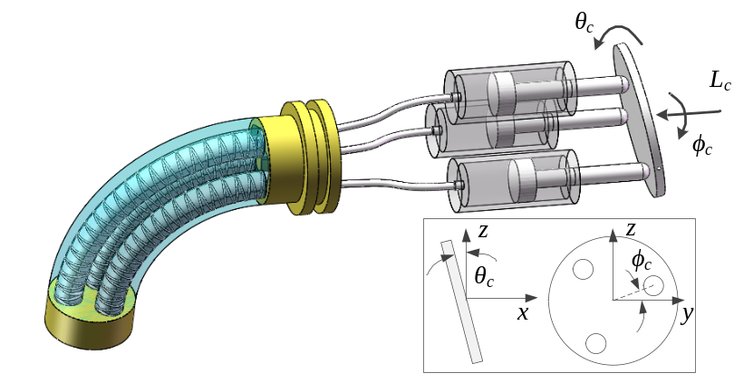
Design and Test of an Electrohydraulic Control Device for Three-Chamber Soft Actuators
Tao Wang, Zhen Chen, and Shiqiang Zhu
Ocean College, Zhejiang University, China
An electrohydraulic control device with decoupling function is developed by using a swash plate mechanism.
Stretched length, bending angle, and yaw angle of three-chamber soft actuators can be independently controlled.
A prototype is fabricated and experimental results verify the effectiveness of the proposed concept.
Schematic of proposed electrohydraulic control device

