Slide 1
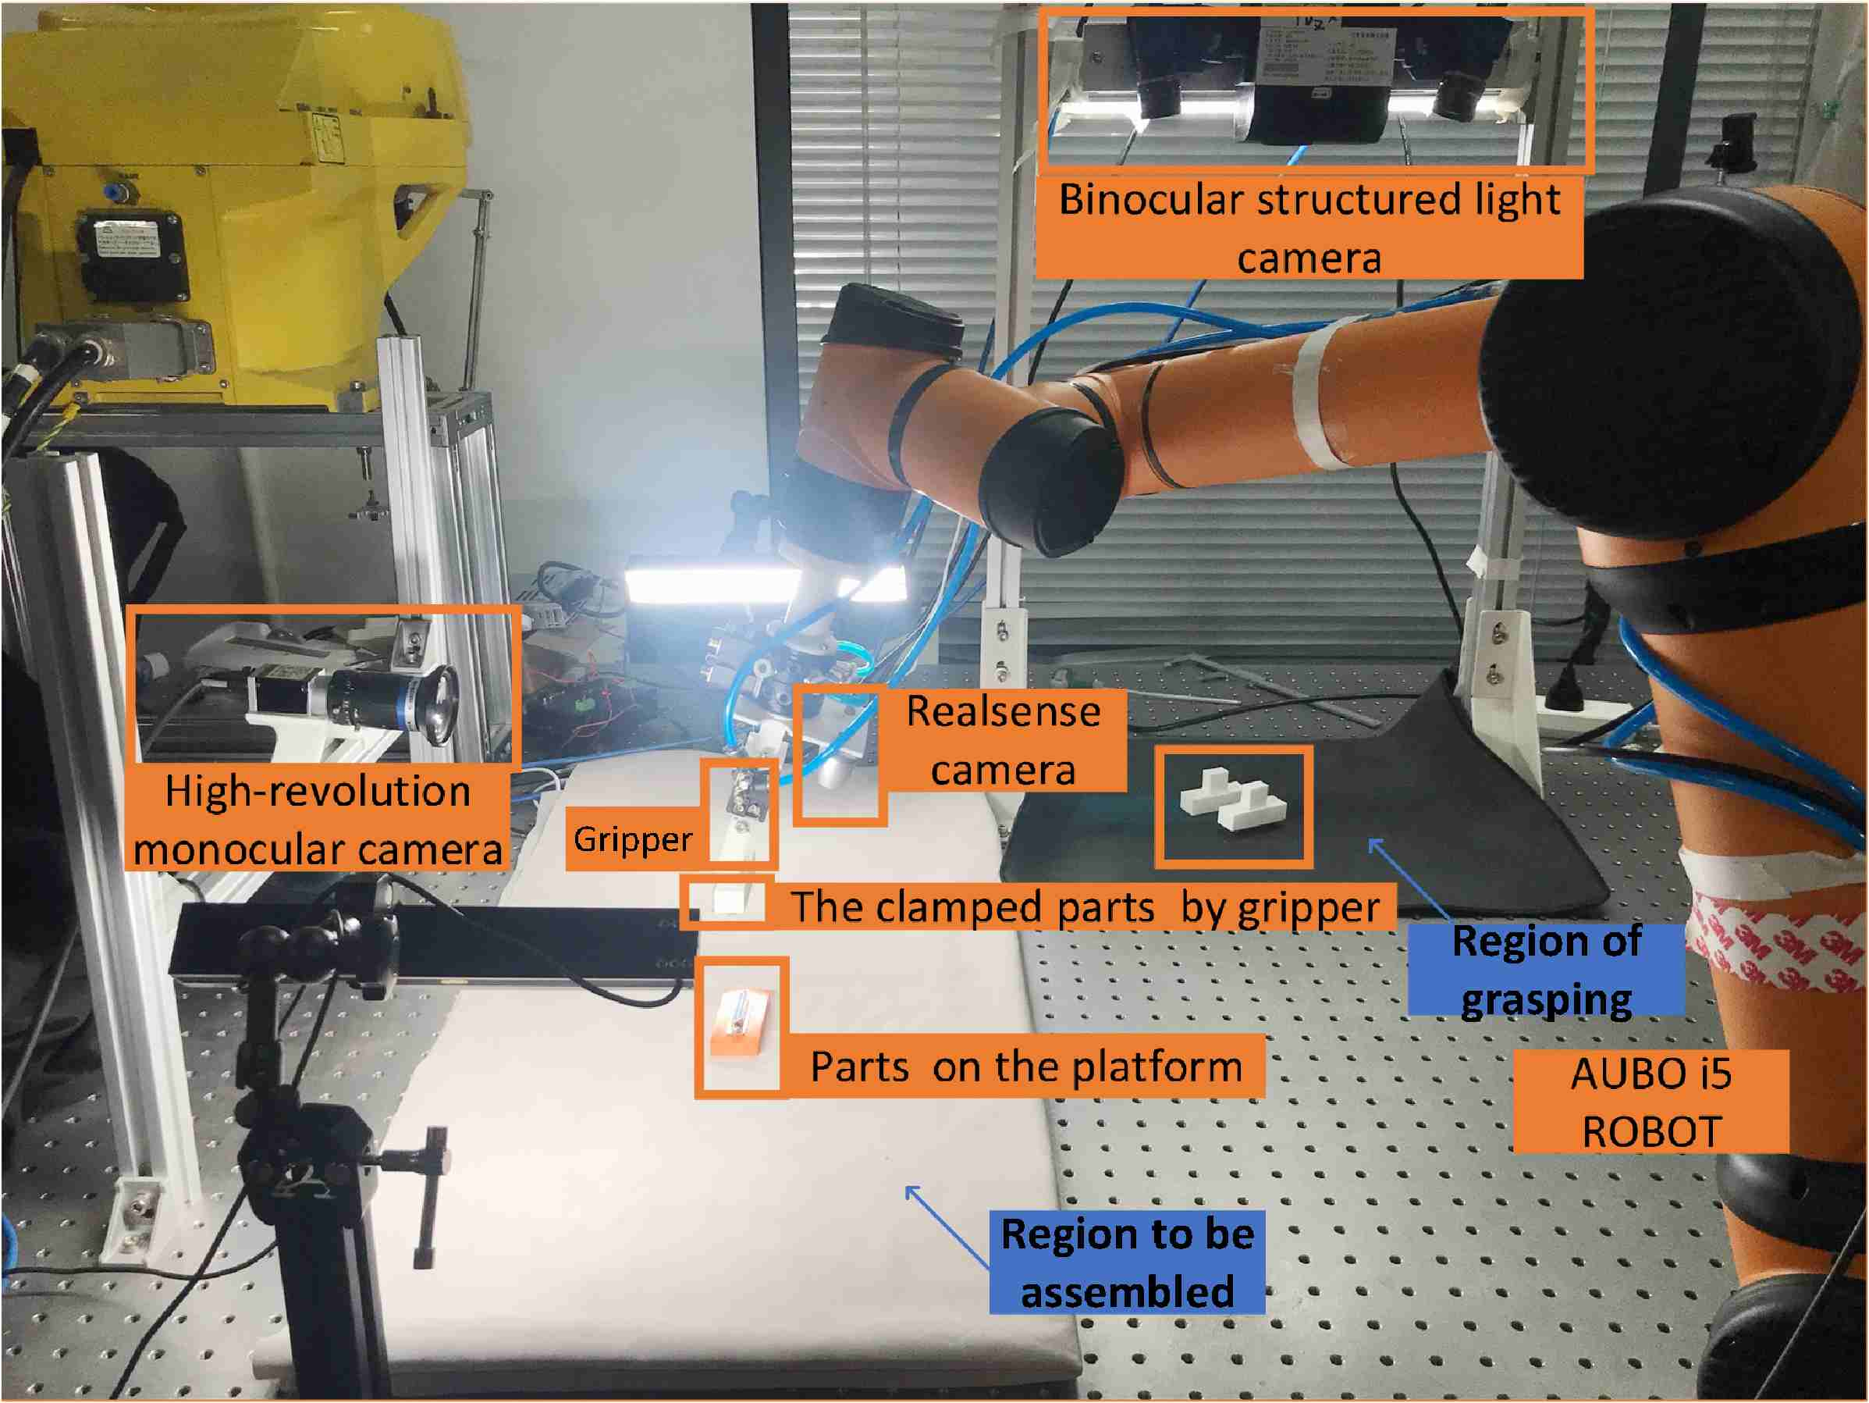
A High-Precision Assembly System of 3C Parts Based on 6D Pose Estimation and Visual Servoing
Yixin Xie, Nan Zhang, Xiansheng Yang and Yunjiang Lou
School of Mechanical Engineering and Automation, Harbin Institude oaf Technology, Shenzhen, China
This paper presents an automatic high-precision assembly system.
A pose compensation strategy and real-time visual servoing approaches are flexibly implemented.
Can tackle the assembly tasks even if two parts both exist uncertain poses.
The high-precision assembly experiment platform

