Slide 1
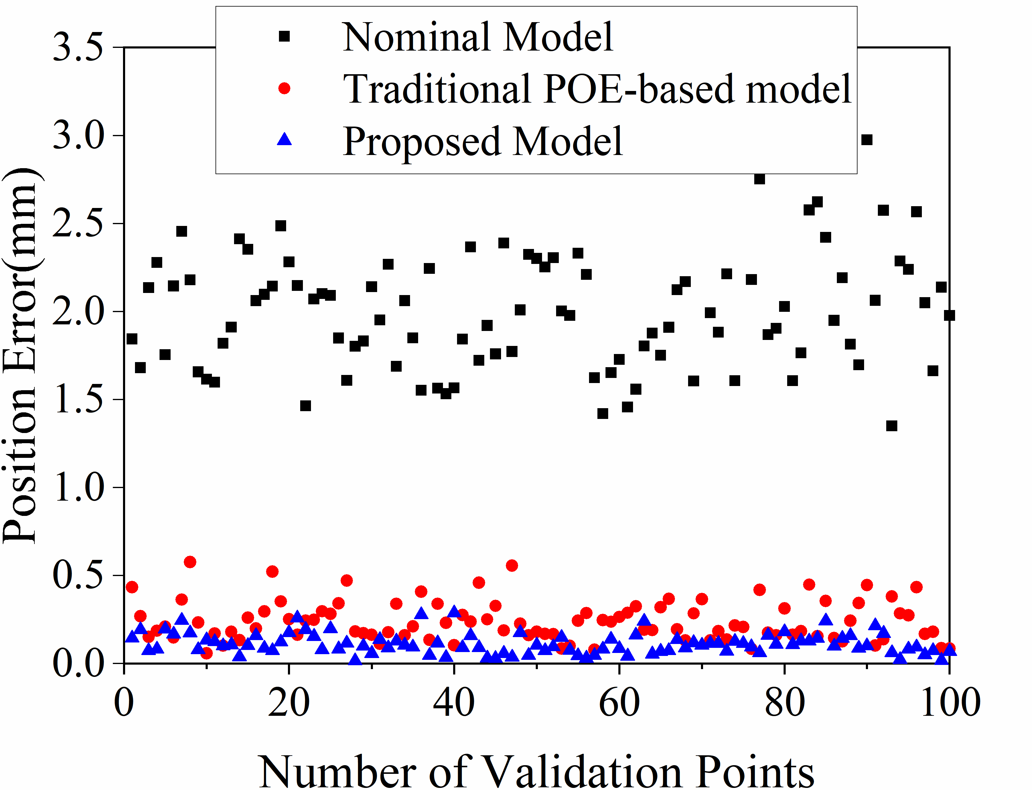
A Generalized Kinematic Error Modeling Method for Serial Industrial Robots Based on Product of Exponentials Formula
Zeyin Zhao, Xin Wang, Jiafan Chen and Mengzhong Chen
School of Mechanical Engineering and Automation,
Harbin Institute of Technology Shenzhen, China
Based on POE formula, a genaralized kinematic error model is proposed.
The Levenberg-Marquardt method is used to identify the unknown model parameters.
Experiments carried out on an Efort ECR5 robot have varified the accuracy of the model.

