Slide 1
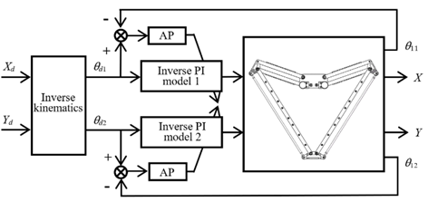
Closed-loop Control of a Pneumatic Artificial Muscle Actuated 2-DOF Delta Mechanism with Adaptive Hysteresis Compensation
Haoqi Zhang, Yuankai Xu, Yanding Qin, Jianda Han
College of Artificial Intelligence, Nankai University, China
Direct inverse modeling approach was utilized to obtain the PAM’s inverse hysteresis model.
The parameters of PI inverse model are identified online by AP algorithm.
The control performance is verified by trajectory tracking.
Block diagram of the closed loop control system

