Slide 1
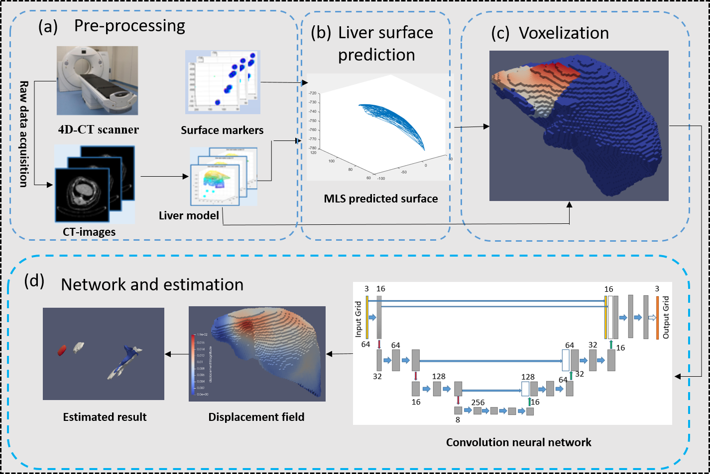
Internal Motion Estimation during Free-Breathing via External/Internal Correlation Model
Yangyang Shi
Wuhan Research Institute of Posts and Telecommunications, China
Yuqi Tong and Ruotong Li and Weixin Si*
Shenzhen Institute of Advanced Technology, Chinese Academy of Sciences, China
Two-step external-internal correlation model
MLS based liver surface prediction
CNN based non-rigid registration
Accurate estimation of the target structures
Improve clinicians’ perception of vessels and tumors
A figure here
The overview of our workflow

