Slide 1
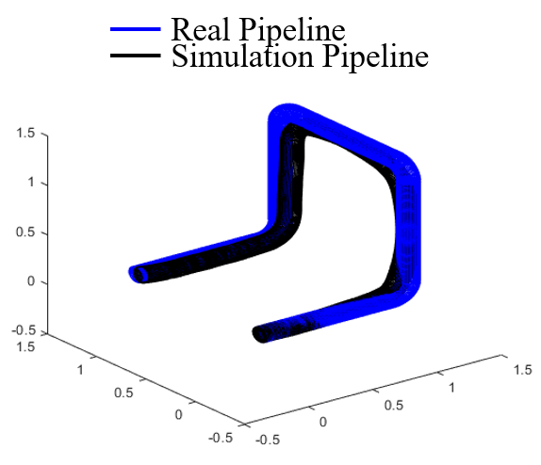
Visualized Small-size Pipeline Model Building Using Multilink-articulated Wheeled In-pipe Inspection Robot
Dianzhen Guo and Jianjun Yuan
Shanghai Robotics Institute, Shanghai University, China
Zhaohan Yuan
Robotics Institute, Shanghai Jiao Tong University, China
The robot is suitable for the inspection of pipelines with diameters between 120mm and 180mm.
The visualized pipeline model building is based on small size inertial measurement unit (IMU) and encoder.
A multi-sensor data fusion algorithm is used to improve the accuracy of the visualized pipeline model.
Pipeline visualized model.

