Slide 1
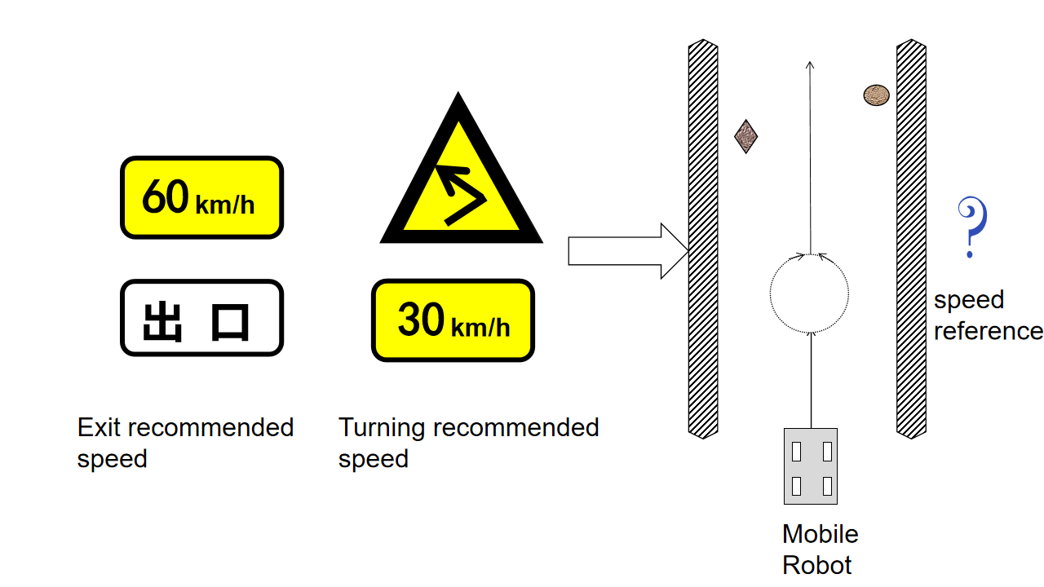
An Intelligent Speed-Suggestion Planner for Coverage Path with Multiple Constraints
Xinbo Ma and Guolai Jiang and Yuanzhe Peng and Tingchen Ma and Chao Liu and Yongsheng Ou
Shenzhen Institutes of Advanced Technology (SIAT),
Chinese Academy of Sciences (CAS), China.
We introduce the commonly used traffic regulations in daily life into the generation of speed profiles.
We construct a cost function to evaluate the safety performance of the trajectory, which can better evaluate different experimental results.
Our proposed method achieves not only high safety but also efficiency in the tracking of coverage paths.
A figure here
Introduce the traffic regulations into the generation of speed profile

