Slide 1
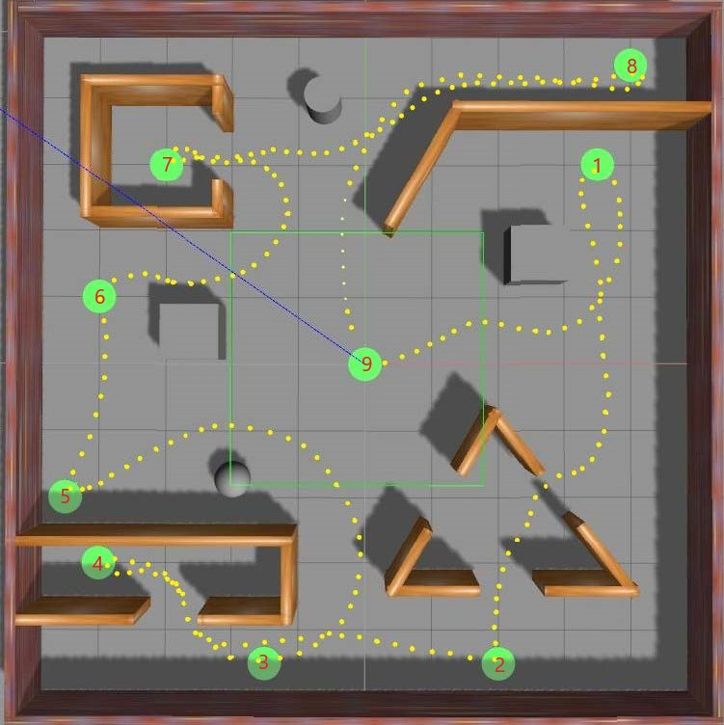
Autonomous mobile robot navigation in uncertain dynamic environments based on deep
reinforcement learning
Zhangfan Lu and Ran Huang
College of Information Science & Technology, Beijing University of Chemical Technology, China
This paper proposes E2E navigation based on deep reinforcement learning.
Use multi-time environmental information to ensure continuous navigation.
The proposed method has the property of safe and fast navigation in uncertain dynamic environments.
Simulation results have verified the efficacy of the proposed method.
Global navigation route

