Slide 1
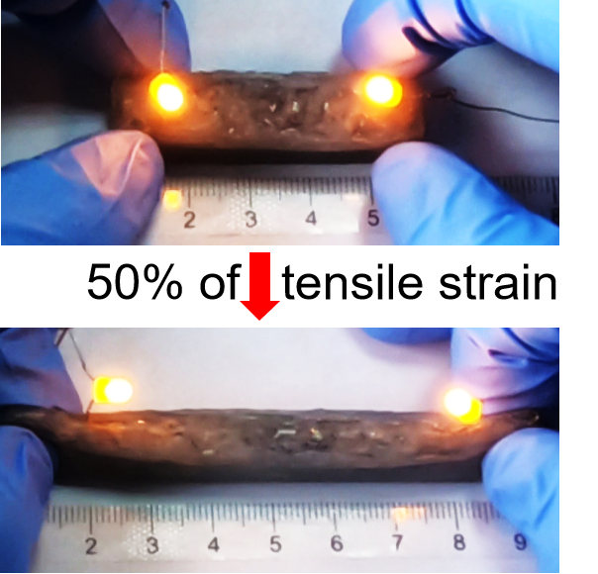
Stiffness-Tunable and all-soft electrical smart material made by magnetic liquid metal and sponge
K. Wang, J. Zhou, S. Li, J. Hu, J. Yang,
M. Liu, H. Yang, X. Li, and L. Sun
School of Mechanical and Electric Engineering, Soochow University, China
S. Zhang
Department of Precision Machinery and Precision Instrumentation, University of Science and Technology of China, China
Z. Huan and W. Ma
School of Electrical Engineering and Automation, Xiamen University of Technology, China
We present a novel and easy method to design and manufacture mechanically durable, all-soft electrical and stiffness-tunable MLM-sponge elastomer.

