Slide 1
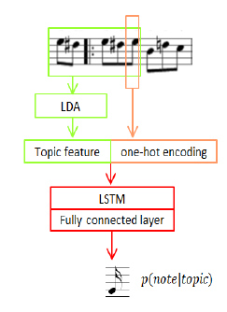
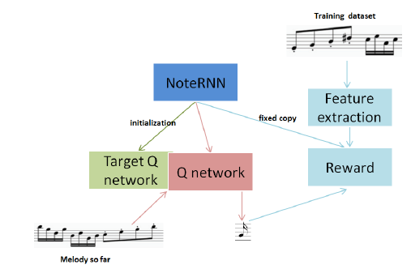
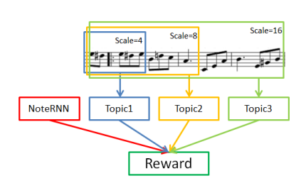
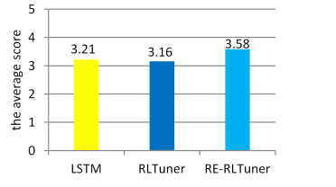
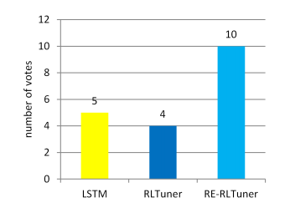

RE-RLTuner: A topic-based music generation method
In our work, we aim to extract music rules from given corpora and then apply them to generate new music of a similar style. We divided the melody into different scales based on the music structures and then employed Latent Dirichlet Allocation (LDA) topic model to learn the structural constraints of the provided musical form. The multi-scale fusion of musical features through reinforcement learning (RL) enables the model to consider the music generation from the global scope.
Our experimental results show that our model is superior to the baseline model according to objective and subjective rating. The music generated from our model has better consistency in terms of music style, which indicates that the extracted structural features and the multi-scale modeling are promising for music generation of a certain style topic.

