Slide 1
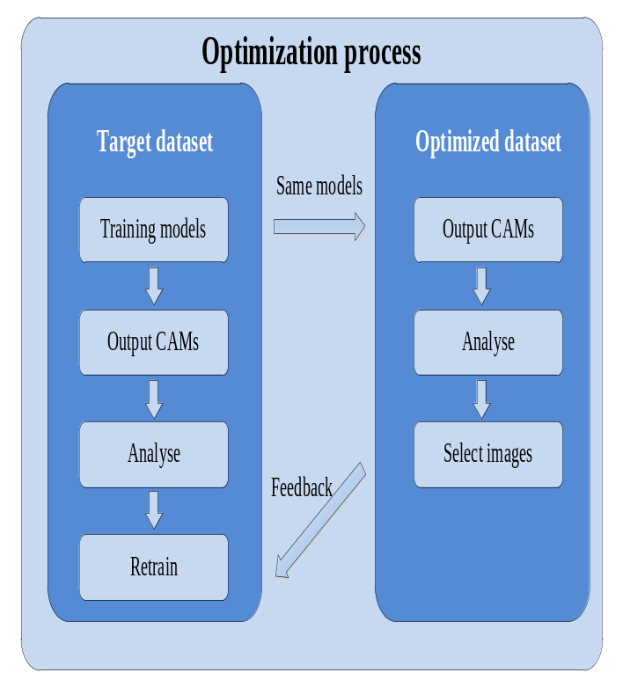
Deep Convolutional Neural Network Transfer Learning
Optimization Based on Visual Interpretation
Yibo Xu, Jiongming Su, Fengtao Xiang, Ce Guo, Haoran Ren, Huimin Lu
College of Intelligent Science, National University of Defense Technology, China
A figure here
Introduce "feedback" to pre-recognize optimized datasets
Visual interpretation of military images using class activation mapping
Optimization of the training set for the test set
For figure caption (optional), use arial narrow 20pt font

