Slide 1
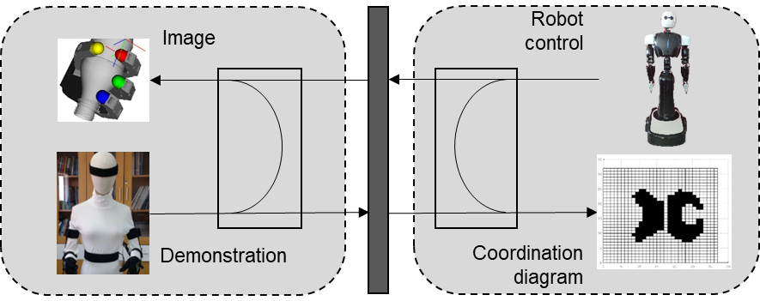
Dual Arm Coordination with Coordination Diagram based on Teleoperation Demonstration
Guoyu Zuo, Zichen Xu, Lu Liu, and Daoxiong Gong
Faculty of Information Technology, Beijing University of Technology, China
Jianfeng Li
Faculty of Materials and Manufacturing, Beijing University of Technology, China
This paper proposes a dual-arm coordination algorithm to improve the efficiency of coordination.
Consider both robot’s actions and operating sequences for tasks that require multiple operations with both arms.
The coordination diagram in time domain is designed to more clearly represent the situations of trajectory collisions and find the collision free coordination action law.

