Slide 1
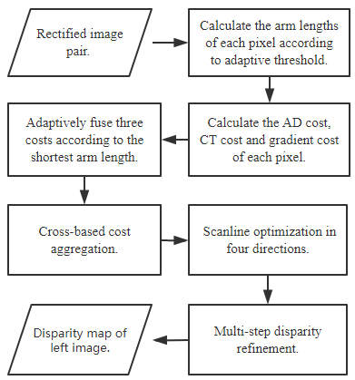
Stereo Matching Algorithm Based on Two-phase Adaptive Optimization of AD-Census and Gradient Fusion
Hao Liu
School of Optical and Electronic Information, Huazhong University of Science and Technology, Wuhan, China
Wei Chen
Shenzhen Institute of Advanced Technology, Chinese Academy of Sciences, Shenzhen, China
An adaptive cross arm construction method is proposed.
Gradient information is used as one of the similarity measurement criteria.
AD, CT and gradient cost are adaptively fused according to the shortest arm length.
System diagram of the proposed algorithm

