Slide 1
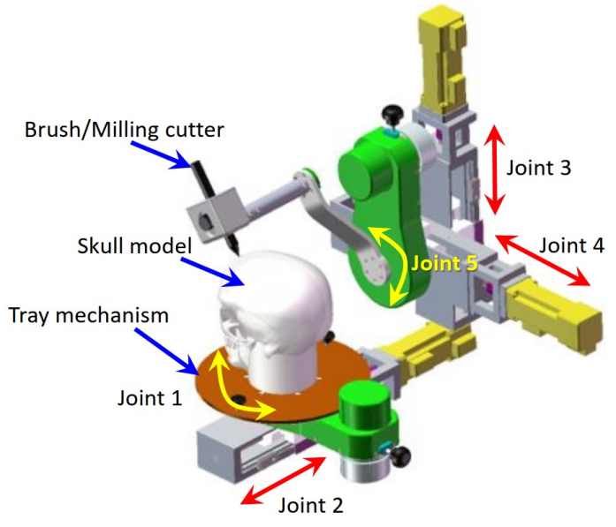
Kinematics Modeling and Trajectory Planning for the Skull Reconstruction Robot
Weiqun Wang¹, Xiru Wang², Zeng-Guang Hou¹, Zhijie Fang¹, Yuze Jiao¹, Yangyu Luo¹ and Jian Gong³
1.the State Key Laboratory for Management and Control of Complex Systems, Institute of Automation Chinese Academy of Sciences, China
2.Department of Electronics, Polytech Nice Sophia, France
3. Department of Pediatric Neurosurgery, Beijing Tiantan
Hospital, Capital Medical University, China
A skull reconstruction robot has been developed firstly in the world
The contour data for cutting are obtained based on the laser scanning sensor
A PCA based method is designed to ensure the end tools perpendicular to the skull surface
A polynomial interpolation based method is designed to construct the curves between adjacent key points.

