Slide 1
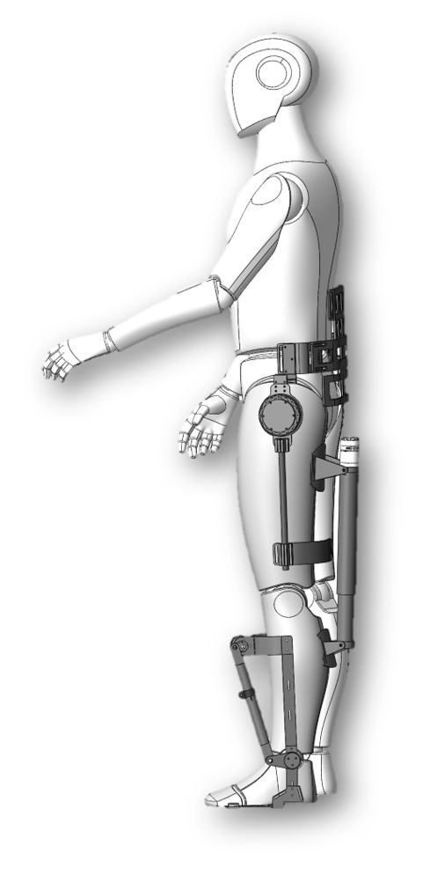
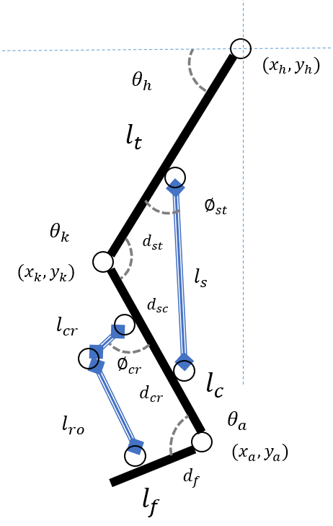
Impedance Control for a novel Composite Modular Lower-Limb Hemiplegic Exoskeleton
Ruoyu Bao, Pengbo Li, Bailin He,Zhilong Su,Can Wang and Xinyu Wu
Shenzhen Institute of Advanced Technology, Chinese Academy of Sciences,
Shenzhen
Proposes a control scheme based on impedance control to realise the smoothing control of the operating movements of the lower limb hemiplegic exoskeleton robot.
Simplifies the control complexity of the whole system by means of a crank rocker structure of the ankle joint.

