Slide 1
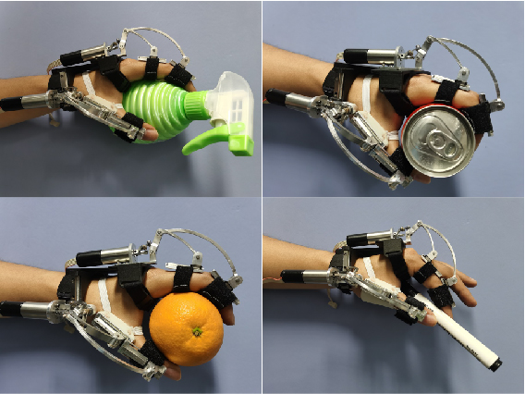
UCAS-Hand: An Underactuated Powered Hand Exoskeleton for Assisting Grasping Task
Houcheng Li^{1,2}, Long Cheng^{1,2}, Zhengwei Li¹, and Guotao Li¹
1. State Key laboratory of Management and Control for Complex Systems, Institute of Automation, Chinese Academy of Sciences, China
2. School of Artificial Intelligence, University of Chinese Academy of Sciences
The UCAS-Hand is the first linkage-based exoskeleton to achieve the human-robot kinematic compatibility of the thumb joint.
The UCAS-Hand can realize the self-adaptive grasp to different objects, apply only normal forces, and is passively backdrivable.
The UCAS-Hand can achieve the thumb underactuated movement by constructing a spherical seven-bar linkage.

