Slide 1

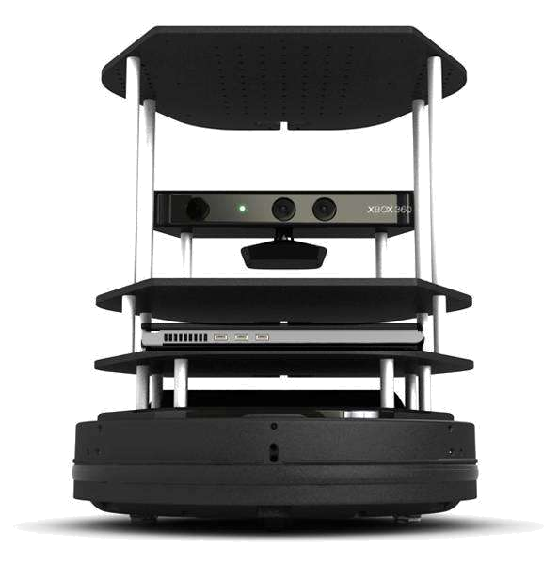



Cloud-based Robot Path Planning in Dynamic Environments
Xinquan Chen, Lujia Wang and Xitong Gao
SIAT, Chinese Academy of Sciences, China
Cheng-Zhong
the University of Macau, China
Cloud-base framework for multi-agent path planning under dynamic environments.
Modified A* global planner to make plans safer and more reasonable.
Inproved APF local planner to make obstacle avoidance more simple and effective.

