Slide 1
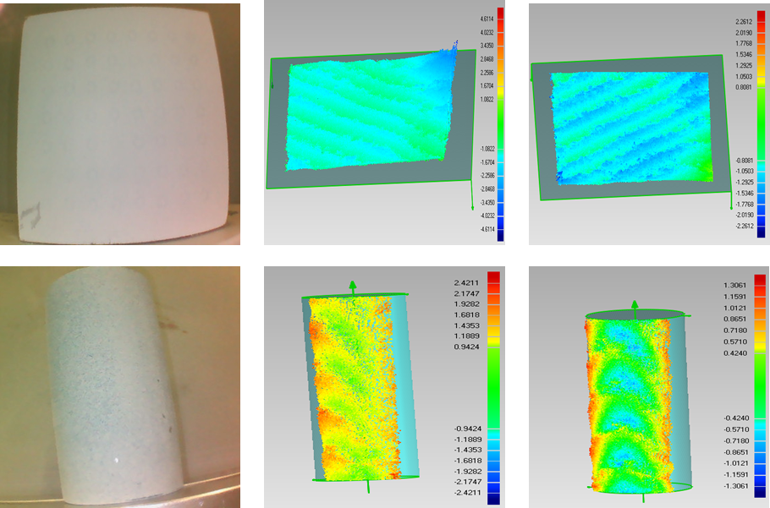
An Accurate Speckle 3D Reconstruction System Based on Binocular Endoscope
Junguang Guo¹, Feifei Gu¹ ,Yuping Ye¹ and Zhan Song^{1,2}
¹Shenzhen Institute of Advanced Technology, Chinese Academy of Sciences, China
²The Chinese University of Hong Kong, China
A high-accuracy calibration method is proposed to calibrate the system.
An improved Semi-Global Matching (SGM) algorithm is proposed to improve the correctness of the stereo matching.
The experimental results showed that, the proposed algorithm we put forwarded can play a significant role in improving the 3D measurement accuracy.

