Slide 1
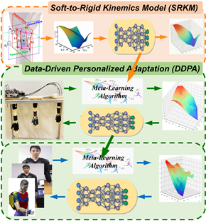
Personalized Assistance Learning for Soft Wearable Robot
Ning Li, Wenyuan Chen, Yang Yang, Tie Yang, Peng Yu, Wenxue Wang, and Lianqing Liu
Shenyang Institute of Automation, Chinese Academy of Sciences, China
Ning Xi
University of Hong Kong
Uncertainty of model for soft structure and the diversity of motion parameters restrict the application in exoskeleton robots
Personalized control can adapt to different characters and improve control performance
Model-based meta-learning to adapt new individuals more quickly based on the prior knowledge of learned individuals

