Slide 1
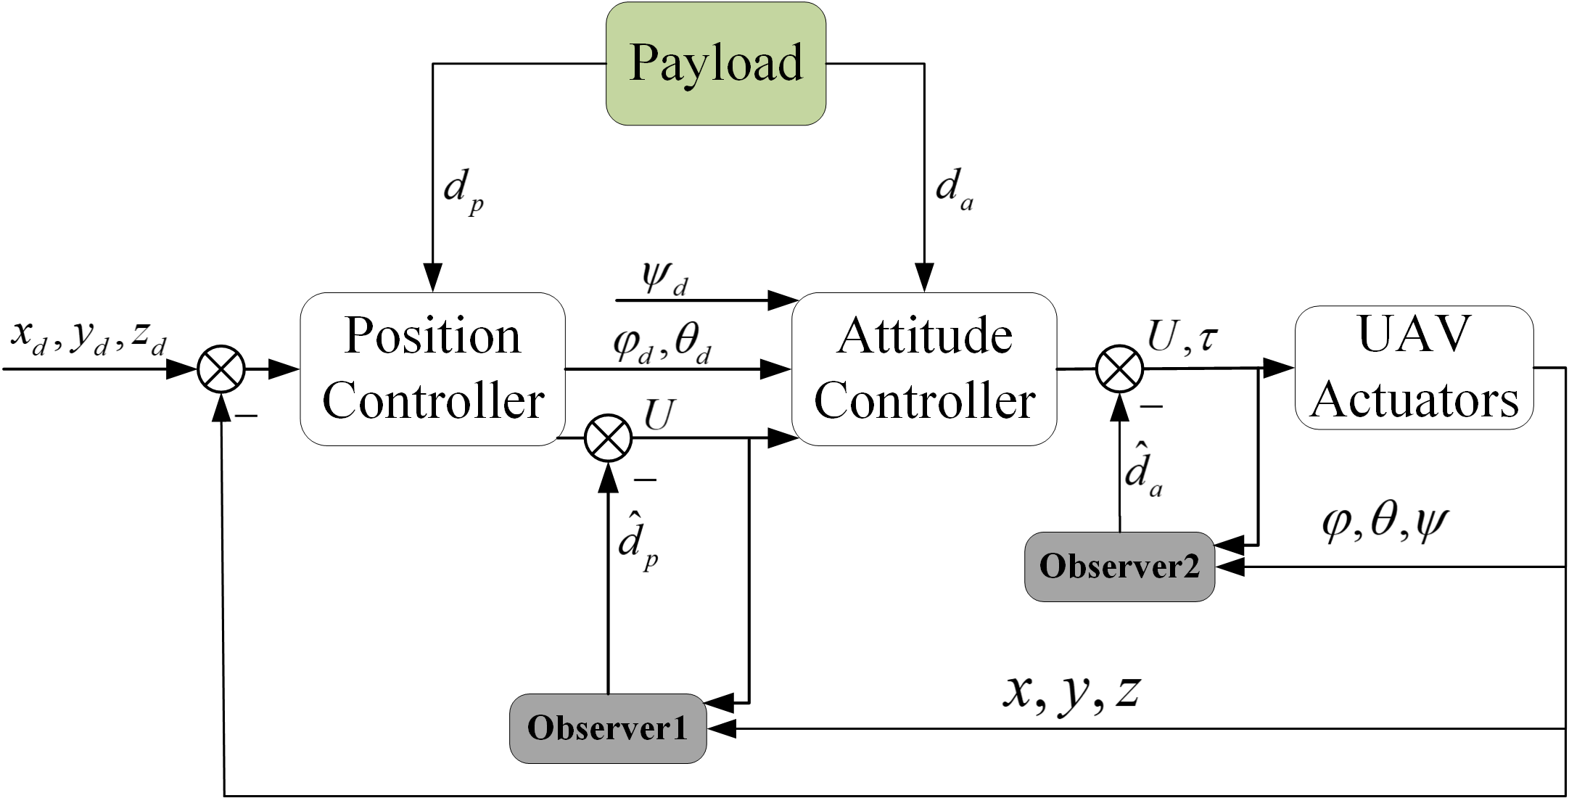
IEEE RCAR 2020 Digest
Observer-based Second Order Sliding Mode Control for TetheredQuadrotor Transportation
Jiale Gao, Fan Zhang, Panfeng Huang and Ya Liu
the Research Center for Intelligent Robotics, School of Astronautics, Northwestern Polytechnical University, China
Precise control: the disturbance can be ompensated in proposed controller via the signed observer.
Comparative test verification: two different experiments were conducted by hovering test and circling test.
OBSOSMC structure diagram
A double-loops observer-based second order sliding mode control scheme is proposed for tethered quadrotor transportation.

