Slide 1
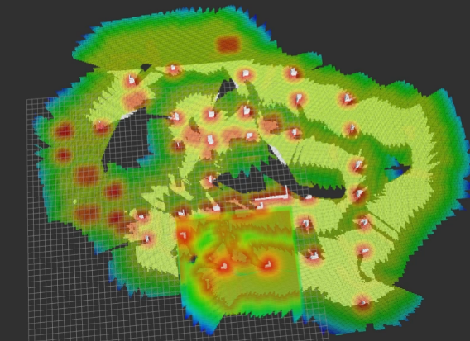
A GPU Mapping System for Real-time Robot Motion Planning
Yizhou Chen and Ben M. Chen
Department of Mechanical and Automation Engineering, The Chinese University of Hong Kong, Hong Kong, China
Shupeng Lai, Feng Lin
Peng Cheng Laboratory
Biao Wang
Department of Automation Engineering, Nanjing University of Aeronautics and Astronautics, Nanjing, China.
Construct Occupancy Grid Maps (OGMs) and Euclidean Signed Distance Fields (ESDFs)
Optimize the global ESDF storage and address the limited observation problem in an efficient manner
Can be applied to robotics onboard sensors.
Propose a real-time robot mapping system on GPU.
A figure here
Constructing ESDF and OGM

