Slide 1
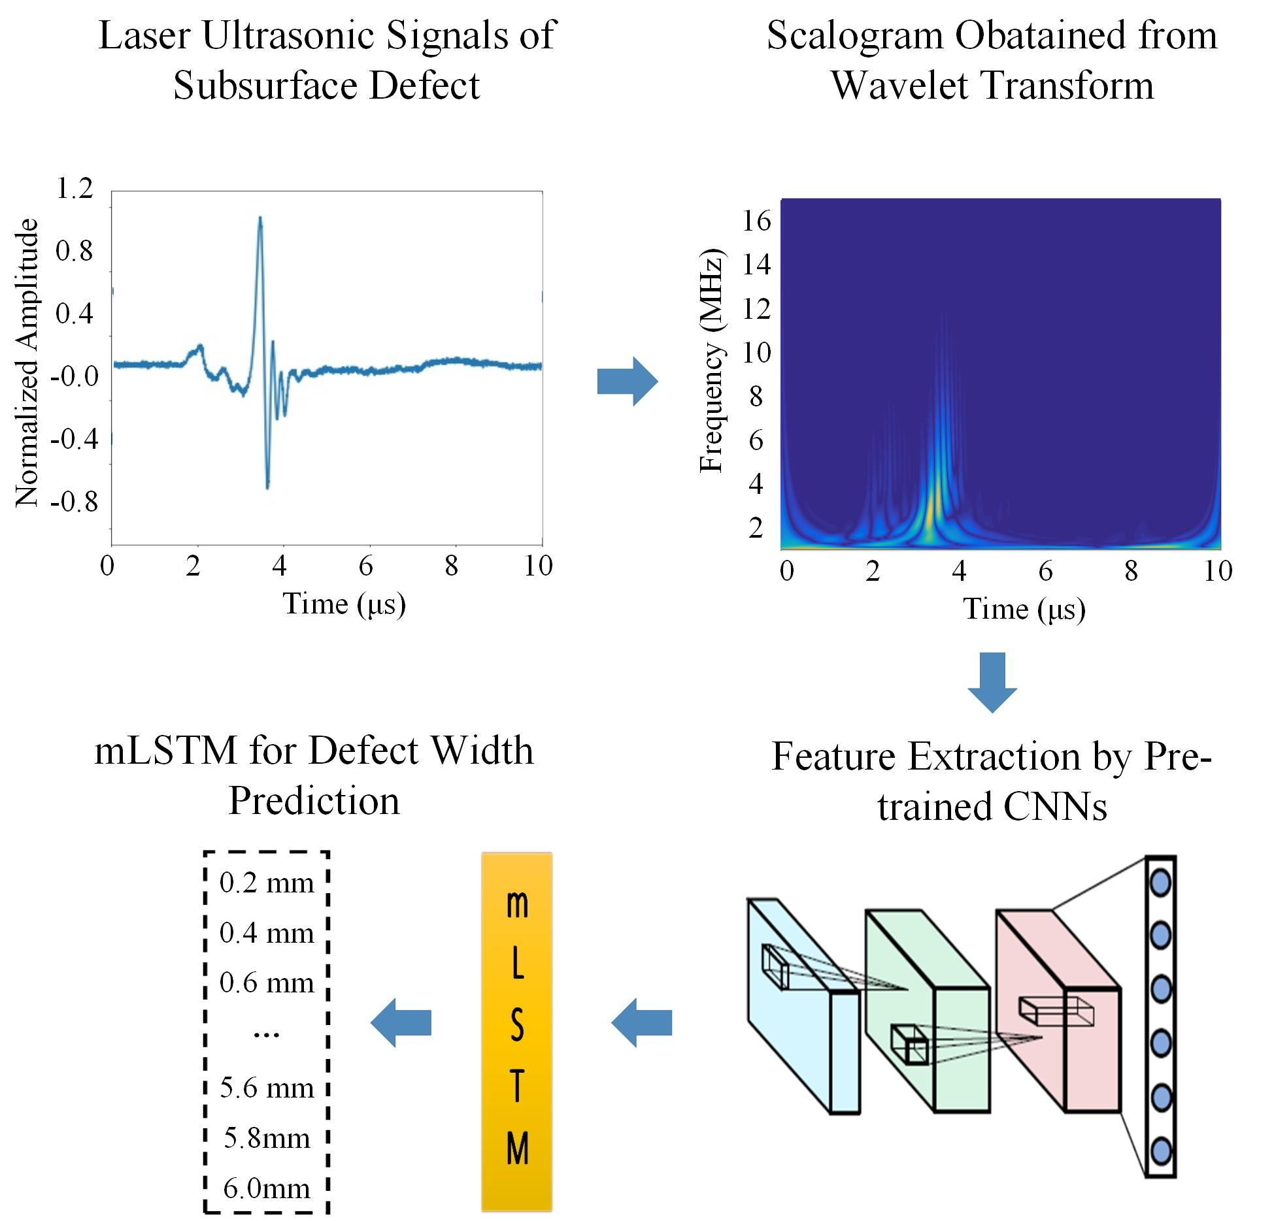
Automatic Quantification Of Subsurface Defects By Analyzing Laser Ultrasonic Signals Using Convolutional Neural Networks And Wavelet
Haowen Feng, Gaolong Lv, Dan Chen and Shifeng Guo*
Shenzhen Institutes of Advanced Technology, University of Chinese Academy of Science, China
Establish validated numerical model to obtain sufficient laser ultrasonic signals for training the CNN model
Convert the laser ultrasonic signals into the scalograms (images) via wavelet transform
Input scalograms to the pre-trained C-NNs model to identify the defect features automatically
A figure here
For figure caption (optional), use arial narrow 20pt font

