Slide 1
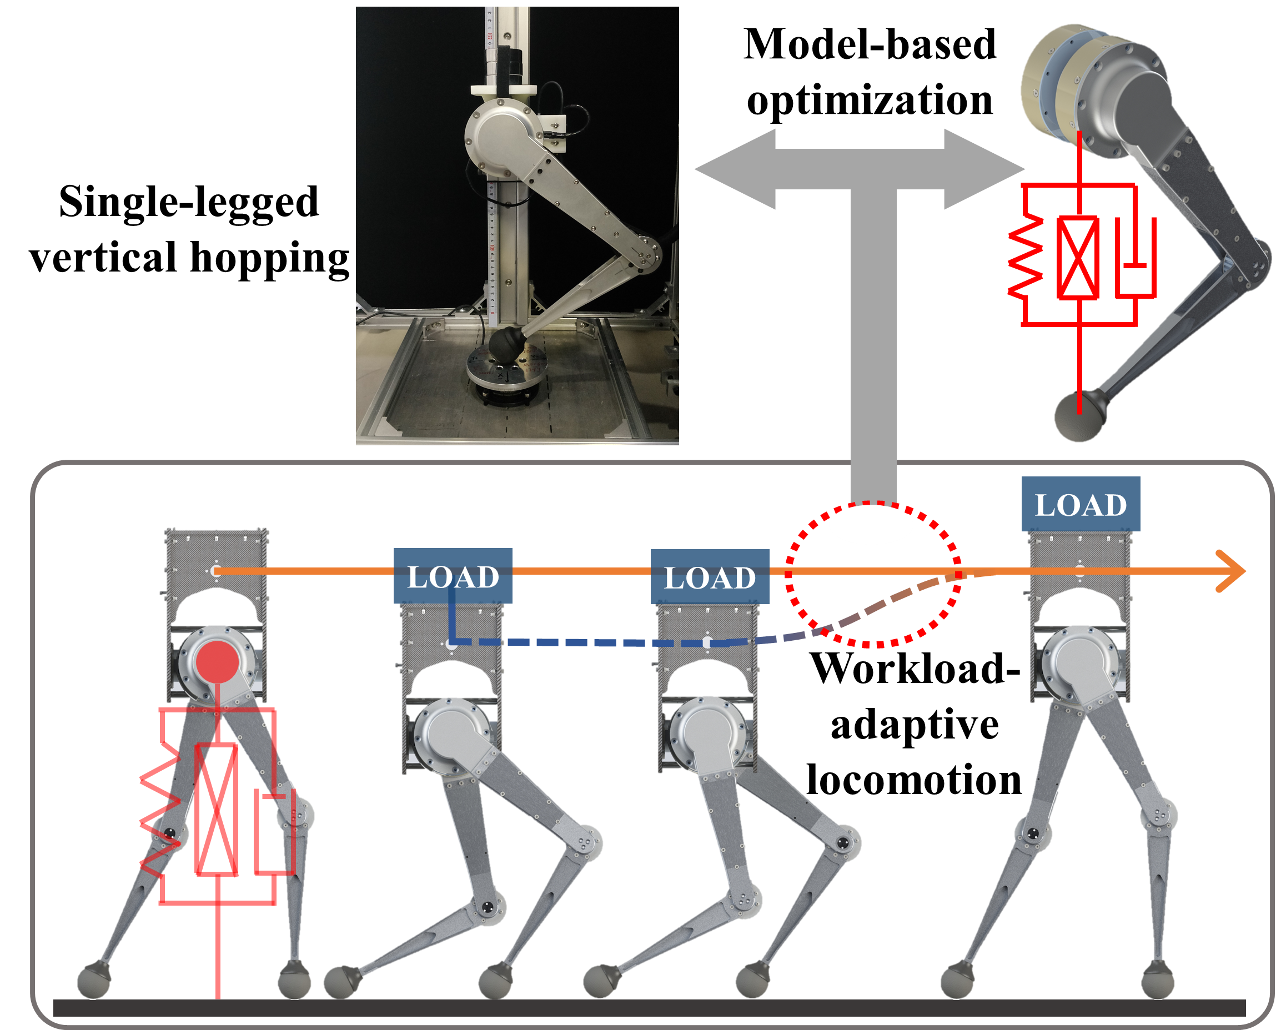
Workload-adaptive Vertical Hopping of A Single-legged Robot using Model-based Optimization
Yongming Yue, Yu Zhang, Wei Gao and Shiwu Zhang
Department of Precision Machinery and Precision Instrumentation,
University of Science and Technology of China, China.
Explored workload adaptive vertical hopping using a single-legged robot.
Fast gait generation given system workloads using SLIP based models and advanced Nonlinear Programming tools.
Experimental verification on physical platform with ±4% accuracy under up to 190% robot’s weight.

