Slide 1
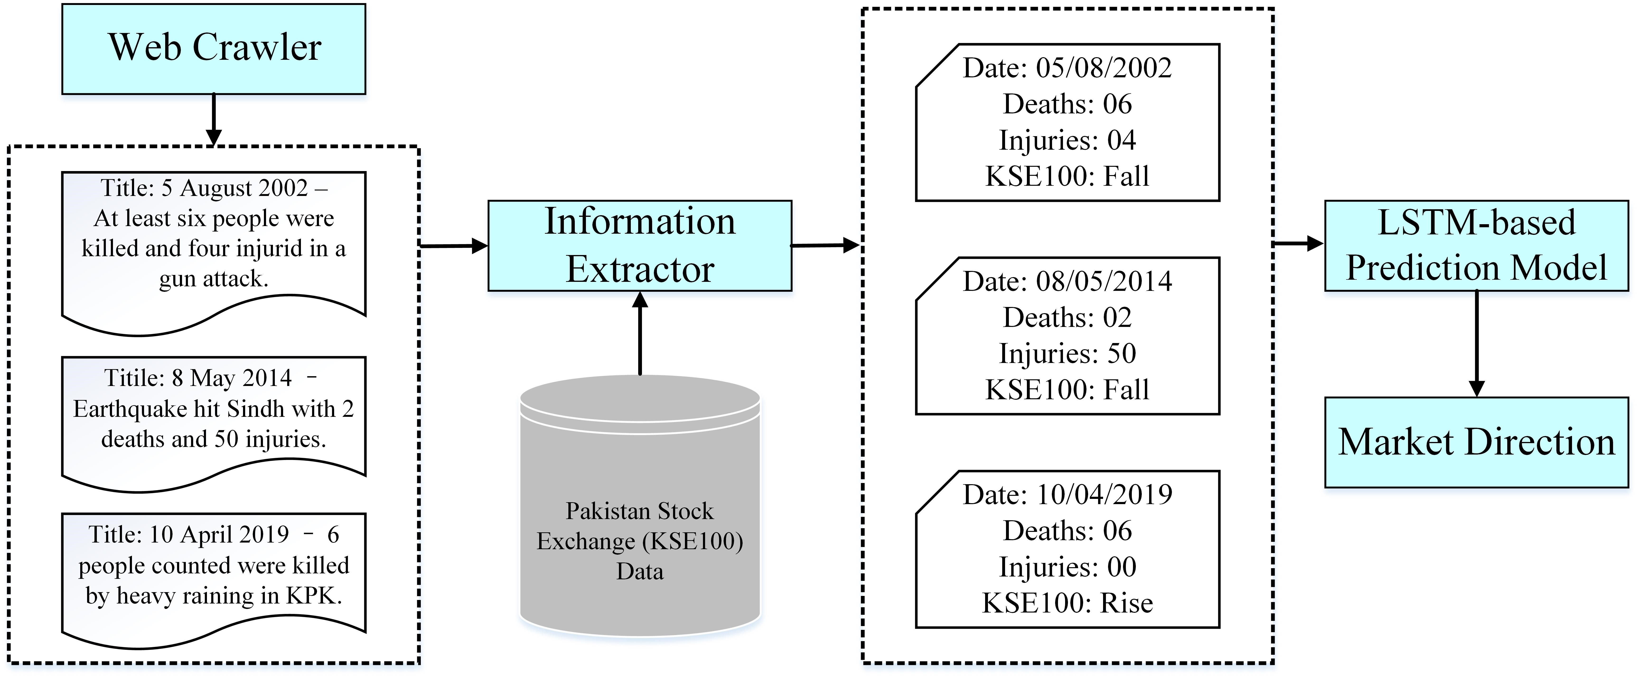
LSTM based Model for Real-time Stock Market Prediction on Unexpected Incidents
Saba Aslam¹, Abdur Rasool², Qingshan Jiang², Qiang Qu²
¹Computer Science, Fast NUCES Chiniot-Faisalabad, Pakistan.
²Shenzhen Key Lab for High Performance Data Mining, Shenzhen Institute of Advanced Technology, Chinese Academy of Sciences, Shenzhen, China.
Build an AI-based LSTM model to predict the stock market direction for unexpected incidents
Find the impact of terrorist attacks, floods and earthquakes incidents on Stock market direction
Web crawler crawls unexpected data → Information extractor → LSTM prediction Model → Market direction
AI-based LSTM model for real-time stock market prediction.

