Slide 1
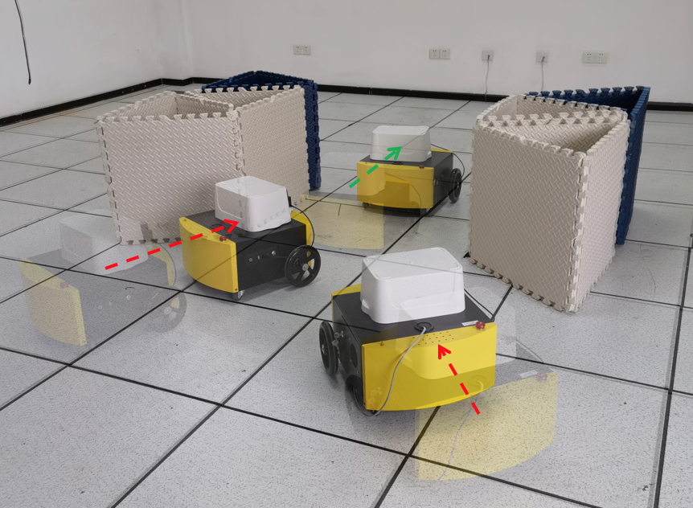
Socially-Aware Multi-Agent Following with 2D Laser Scans via Deep Reinforcement Learning and Potential Field
Yuxiang Cui, Xiaolong Huang, Yue Wang, Rong Xiong
CSE, Zhejiang University, China
We propose a potential ﬁeld based method for formation control and goal assignment.
We propose a deep model of socially-aware following policy trained by reinforcement learning.
Our method can be applied to random environments with an arbitrary number of robots.
We train the policy in a decentralized policy-sharing multi-agent simulation environment.
Real robot evaluation

