Slide 1
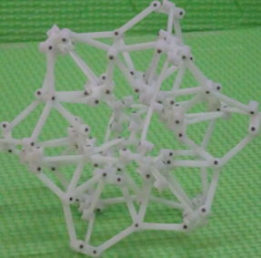
Deployable Polyhedral Mechanisms with Radially Reciprocating Motion Based on Non-crossing Angulated Structural Element
Tao Yang and Peng Li
Harbin Institute of Technology Shenzhen, China
Qing Shi
Being Institute of Technology, China
Yunhui Liu
The Chinese University of Hong Kong, China
Propose a non-crossing angulated element with a constant subtended angle.
Construct a family of deployable polyhedral mechanisms with radially reciprocating motion but no singularity.
Build 3D model both in computer and prototypes to demonstrate the feasibility of the proposed mechanisms.

