Slide 1
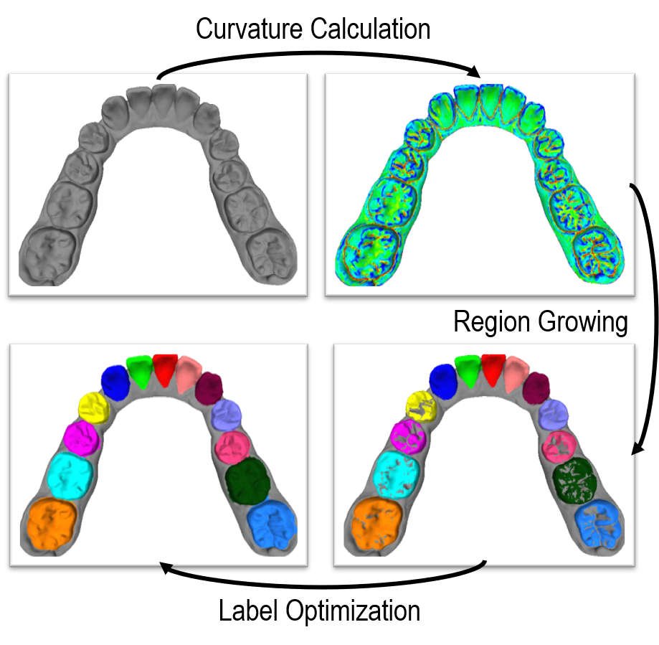
Tooth Segmentation of Dental Mesh Based on Improved Region Growing
Chenlan Gu and Hesheng Wang
Department of Automation, Shanghai Jiao Tong University, China
Ning Zhao
Department of Orthodontics, Shanghai Ninth People’s Hospital, China
Improved region growing algorithm with extended region similarity description
Multi-level label optimization algorithm based on label consistency
Parameter adaptive method

