Slide 1
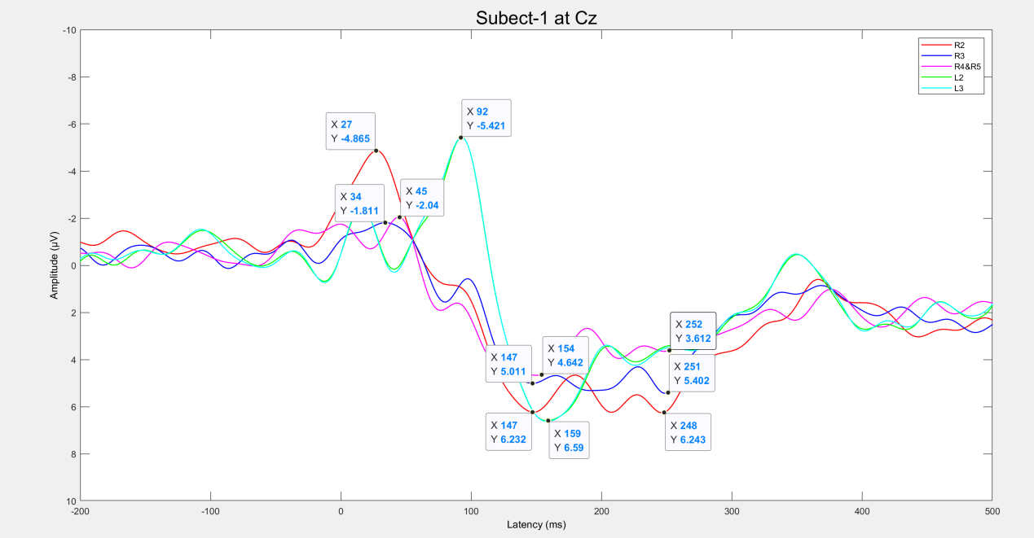
Cognitive Components Characteristic Of Somatosensory Evoked Potentials In Upper Limb Amputees With Evoked Tactile Sensation
Changyu Qin and Wenyuan Liang
The National Research Center for Rehabilitation Technical Aids, China
Sheng Bi
The National Research Center for Rehabilitation Technical Aids, China
Plateau appears in cognitive component of SEP in amputees with PFM
Amputees without PFM cannot evoked cognitive components
Amputees reach the peak of ERP faster than Able-bodied man generally
Distribution of exogenous components on the opposite side of the topographic map
A figure here
the ERP of one subject
at Cz

