Slide 1
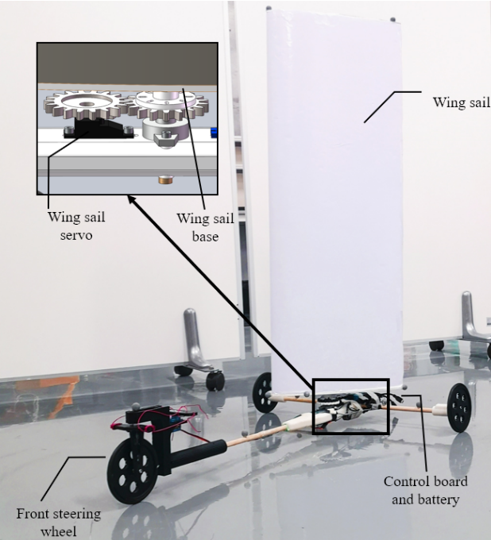
Modeling and Implementation of Tacking for Wing Sail Land-yacht
Yihan Huang, Yang Jiao and Xinyu Chen
The Chinese University of Hong Kong, Shenzhen, China
Lianxin Zhang, Xiaoqiang Ji and Huihuan Qian
Shenzhen Institute of Artificial Intelligence and Robotics for Society, The Chinese University of Hong Kong, Shenzhen, China
A novel lightweight design of low cost three-wheeled land-yacht with a T-frame and a foamed wing sail is proposed.
A model is developed to predict the minimum initial velocity for upwind steering (tacking).
An acceleration error function C in the model is identified by a series of experiments, and tacking experiments with a high success rate of 94.7% verify the steering model.
A figure here
For figure caption (optional), use arial narrow 20pt font

