Slide 1
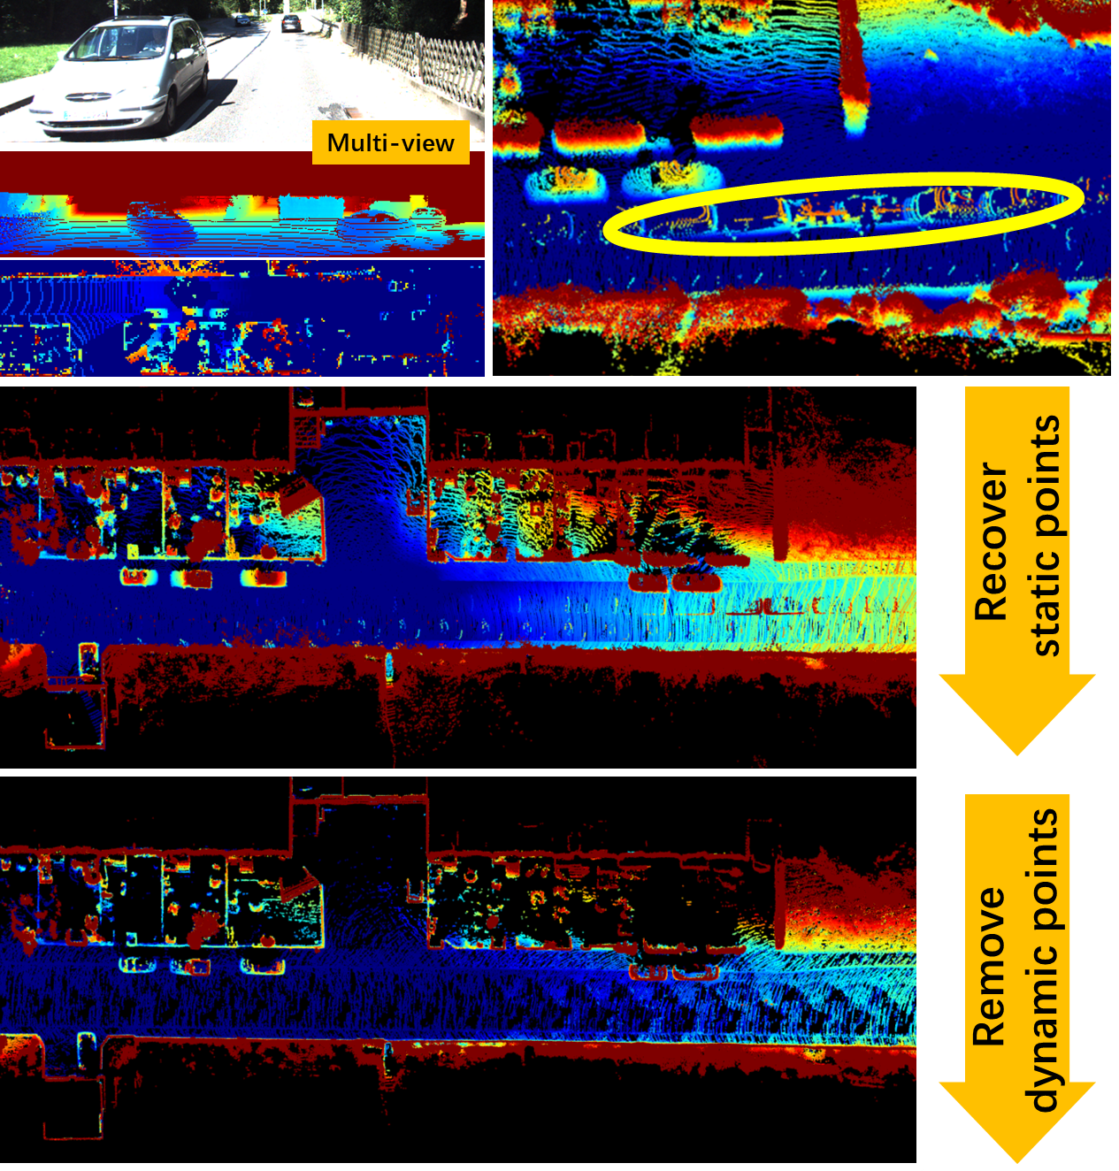
Method for Static 3D Point Cloud Map Building using Multi-View Images with Multi-Resolution
Chen Yao, Hu Zhu, Shipeng Lv, Dingyuan Zhang, Zhenzhong Jia*
Department of Mechanical and Energy Engineering,
Southern University of Science and Technology, China
Multi-view image-based algorithm to robustly detect the discrepancy and correct unreliable calculation of projected images.
A novel recover-then-remove mechanism to generate a pure reliable static 3D point cloud map and exclude dynamic points.
Different view with various resolution to enhance the quality of static maps with adjustable motion ambiguity.

