Slide 1
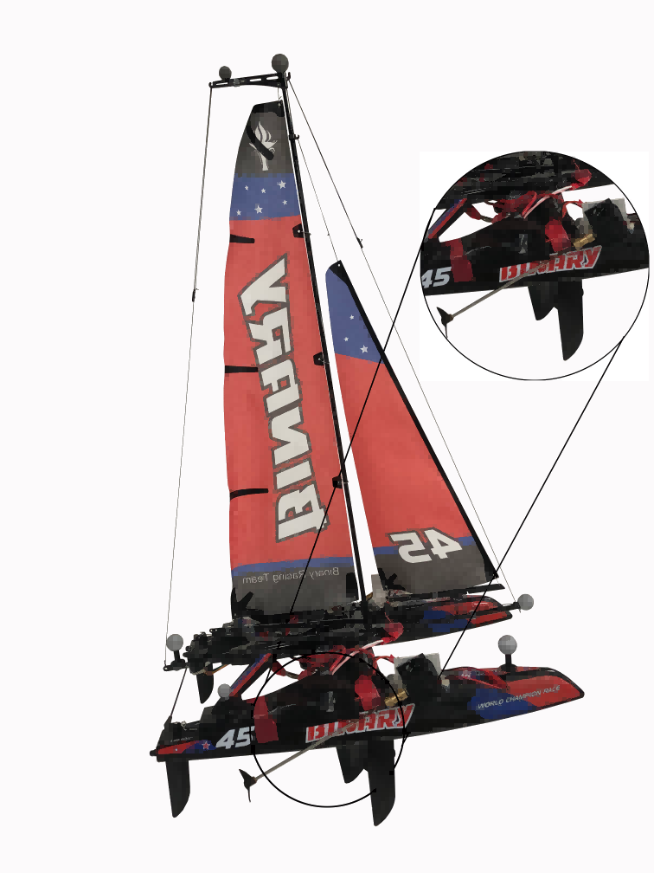
Design and Energy Consumption Optimization of an Automatic Hybrid Sailboat
Rong Ou
Central South University, China
Cheng Liang, Xiaoqiang Ji, Huihuan Qian
Shenzhen Institute of Artificial Intelligence and Robotics for Society,
The Chinese University of Hong Kong, Shenzhen, China
Hybrid Sailboat-Ⅲ, an energy-saving ASV which can make use of both wind and electricity.
It solves the problem of tacking when the sailboat is making a zig-zag path.
Experiments show that new design can significantly decrease energy cost and enhance the course stability of hybrid sailboat.
Hybrid Sailboat-Ⅲ Model

