Slide 1
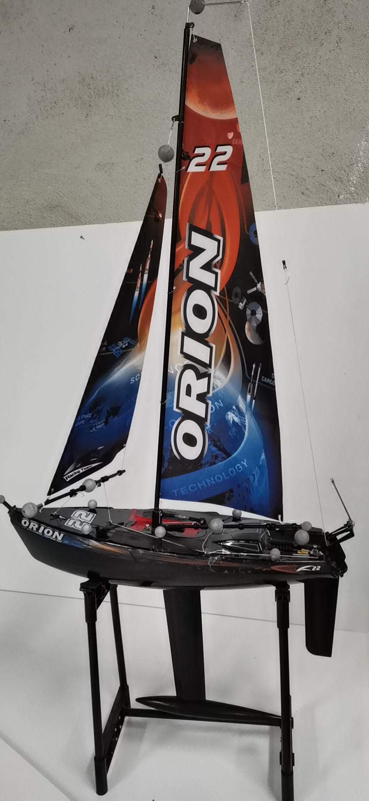
Design of a Battery Carrying Barge for Enhancing Autonomous Sailboat’s Endurance Capacity
Cheng Liang
Shenzhen Institute of Artificial Intelligence and Robotics for Society, China
Rong Ou, Bairun Lin, Xiaoqiang Ji, Ray C. C. Cheung and Huihuan Qian
Department of Electronic Engineering, City University of Hong Kong, China
Shenzhen Institute of Artificial Intelligence and Robotics for Society, China
Autonomous mono-hull sailboat is reformed to tow a battery carrying barge.
The angles of the two sails are optimized to produce maximum lift.
The batteries in the barge provide more energy for the sailboat.
Autopilot tests show greater endurance.
Mono-hull Sailboat

