Slide 1
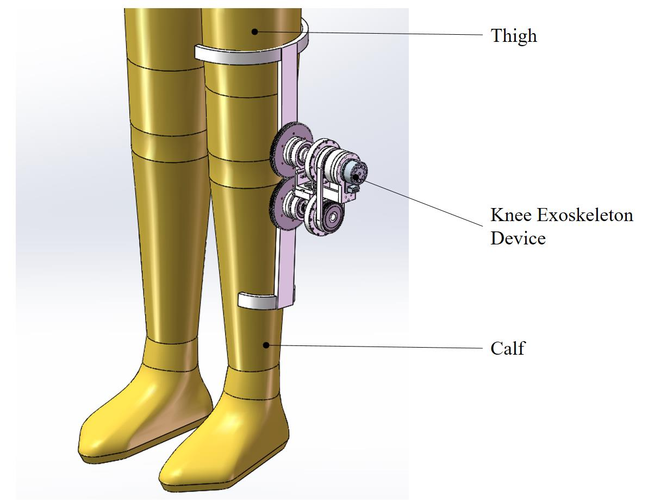
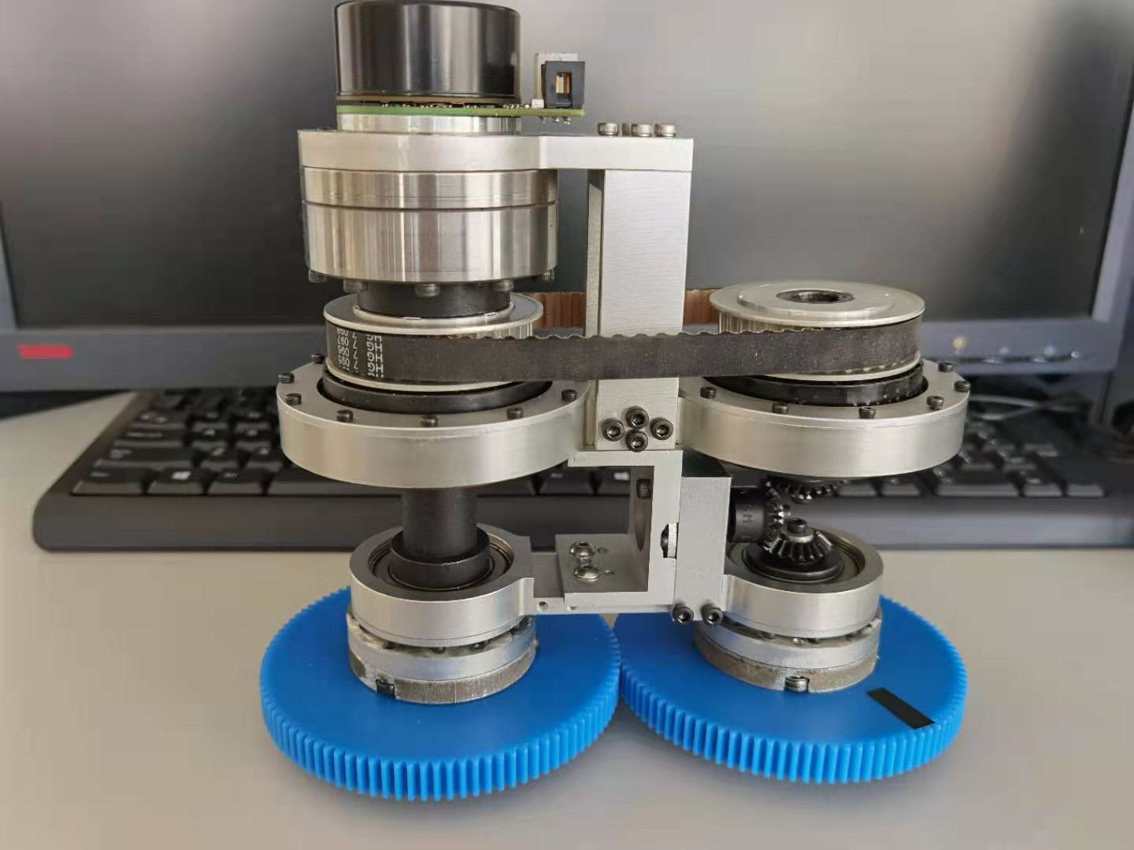
Knee Joint Exoskeleton Device Based on Biological Motion Principle
Wenyuan Liang^{1,2} and Ying Liu^{1,2}
National Research Center for Rehabilitation Technical Aids, China
Key Laboratory of Rehabilitation Technical Aids for Old-age Disability, China
A knee joint exoskeleton device that is designed based on the biological motion principle of human knee joint.
In order to follow the powering patterns of human walking, two one-way bearings and one set of gears are adopted to construct the knee joint exoskeleton device.
The biological motions of femoral-on-tibial extension and tibial-on-femoral flexion can be adaptively imitated by the proposed device.
A figure here
Knee Joint Exoskeleton Device

