Slide 1
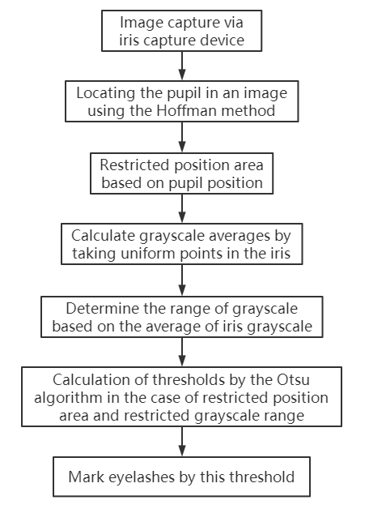
An Eyelashes Segmentation Method Based on Improved Inter-class Variance Maximization Algorithm
Hanlong Zhang
Shenzhen Institute of Advanced Technology Chinese Academy of Sciences, University of Chinese Academy of Sciences, China
Wei Chen
Shenzhen Institute of Advanced Technology, Chinese Academy of Sciences, China
Restrict the location of the region of interest by pupil position.
Limit the grayscale range by the average grayscale of the iris.
Calculation of thresholds by the Otsu algorithm in the case of restricted position area and restricted grayscale range.

