Slide 1
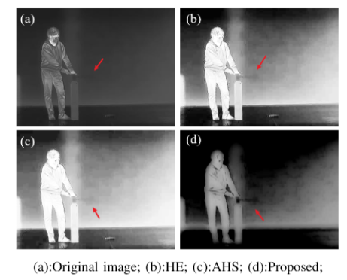
An Infrared Image Enhancement Algorithm for Gas Leak Detecting Based on Gaussian Filtering and Adaptive Histogram Segmentation
Xiaoxi Nie
School of Resources and Environment, University of Electronic Science and Technology of China, Chengdu, China
Wei Chen
Shenzhen Institute of Advanced Technology, Chinese Academy of Sciences, Shenzhen, China
Separate the image into detail and background layers using a Gaussian filter.
Enhancement of detail layers using adaptive histogram segmentation.
Image enhancement by means of local mapping.

