Slide 1
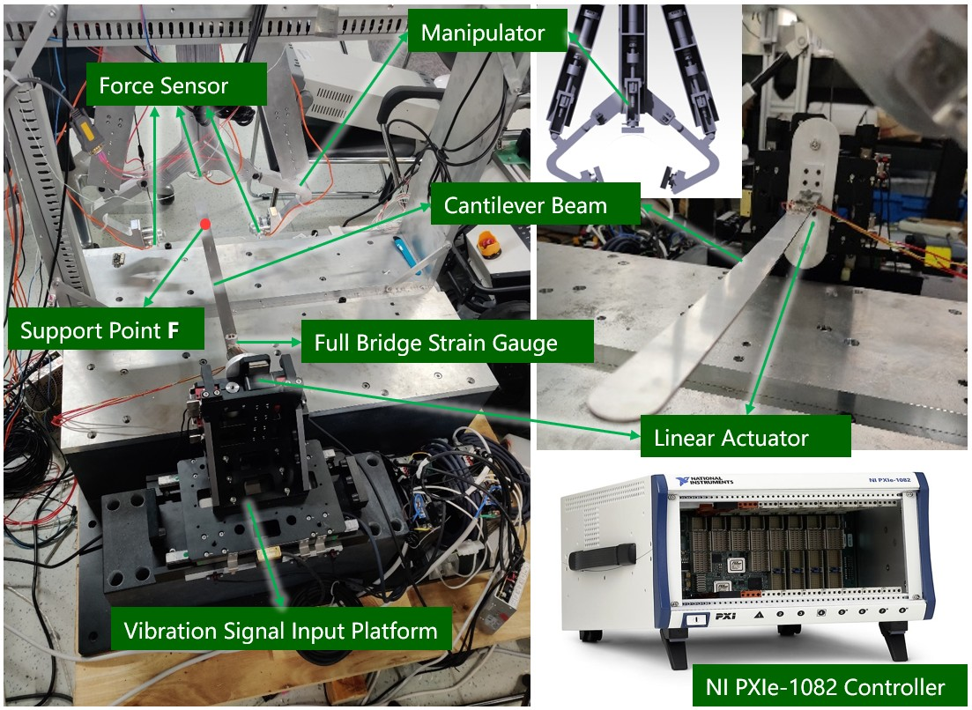
Active Vibration Control of the Cantilever Beam Using a Manipulator
Pengyu Jie, Guangzeng Chen, Ke Li, Yuhao Meng,
Jiangtao Ran and Yunjiang Lou
Harbin Institute of Technology (Shenzhen), Shenzhen, China
Used for vibration suppression of cantilever beam under large deformation.
Structural dynamics is used to predict deformation without terminal deformation or acceleration feedback and a manipulator is used for force output to control vibration.
Active vibration control algorithm is designed based on zero strain expectation.
A figure here
Vibration Control Equivalent Experimental Platform

